Slide 1
2026 CDBG Compliance Workshop
Administrator Training
December 17, 2025

Slide 2
Program Staff
Brooxie Carlton
Assistant Commissioner
Rachel Powers
Deputy Assistant Commissioner
Kent Archer
Director of Community Infrastructure
Lynn Tutor
Assistant Director of Community Infrastructure
Tracey Davis
CDBG Project Manager
Allison Fox
CDBG Project Manager
Kayla Baxter
CDBG Project Manager
Lea Thomason
CDBG Project Manager
Lindsay Gainous
ARC Program Coordinator

Slide 3
Grant Award and Project Setup

Slide 4
Awards and Contracting
Once approved by TNECD Grant Committee award letters are issued
Award letters signal when the following work can begin
  Environmental Review
  Engineering Design
  Administration Costs
Incurred costs cannot be reimbursed until the contract is executed and the Environmental Review approved
Signature Authorization Form (Update anytime personnel changes) – Submit to your Project Manager

Slide 5
Contracting
Contracting process begins shortly after awards
If you know of changes, notify TNECD before contracts are sent out
  Change in mayor
  Additional match funds
  Etc.
Review contracts with local government before returning to TNECD
  Scope
  Budget
  Signatory

Slide 6
Title VI Compliance
Title VI compliance and training occurs after awards
Title VI Survey and non-discrimination policy are required for new grantees
Grantees Title VI information good for 3 years
Select the “Audit & Title VI” tab on our Grant Administration page to find the Title VI training and to submit Title VI documents

Slide 7
Audit Reviews and Risk Assessments
Audit reviews are conducted annually for all grantees with open grants
Risk assessments are conducted annually for all open grants
Monitoring is determined by looking at both the most recent audit performance and the risk assessments
Risk Levels and Monitoring
  Low: Phone Call
  Medium: Desk Review
  High: In-Person

Slide 8
Fair Housing
All CDBG activities must include a fair housing activity that addresses at least one fair housing impediment
Fair housing activities must be approved by ECD
This should be planned and/or conducted as early as possible

Slide 9
Project Timeline – Construction Projects
ERR Due: Varies, 60-120 days after award
Plans and Specs Due: 90 days after LOREC/FNORCC
Bid Opening: 45 days after Plans & Specs Approval
Bid Tabs Due: 14 days after Bid Opening
PCC: After bid award before start of construction
Notice of Start of: After PCC and before construction begins
Construction (Include first HUD-2516 submission)
Project Monitoring: Approximately 50% construction completion
Final Public Hearing: Within 30 days after construction completion
Closeout Due: 15 days after Final Public Hearing
(Closeout will not be approved until final RFP is processed.)

Slide 10
Project Timeline – Equipment Projects
ERR Due: N/A, submitted with application
Plans and Specs Due: 90 days after LOREC/FNORCC
Bid Opening: 45 days after Plans & Specs Approval
Bid Tabs Due: 14 days after Bid Opening
First HUD-2516 Due: After awarding the bid
Project Monitoring: Delivery of equipment
Final Public Hearing: Within 30 days after equipment delivery
Closeout Due: 15 days after Final Public Hearing
(Closeout will not be approved until final RFP is processed.)

Slide 11
Environmental Review

Slide 12
2025 Reg. Round ERR Submission Schedule - adjusted
Environmental Review Type | Submission Deadline
Exempt (15 days – but usually submitted with application) | December 29, 2025
Categorically Excluded converting to Exempt (60 days) | February 11, 2026
Categorically Excluded Subject To (90 days) | March 13, 2026
Environmental Assessment (120 days) | April 13, 2026
2025 regular round HUD Grant Number: B-25-DC-47-0001
Notes:
ERR due dates are normally based on the number of days following the Award Letter date. We have adjusted the due dates to account for updates to the ERR chapter of the CDBG manual. Use these dates as deadlines and submit a formal extension request from the Mayor if the ERR will not be submitted by the listed date. Extension Request letter must include 1) reason for extension request and proposed date the complete ERR will be submitted. Take into account notice publication dates and required comment periods when estimating the extended submission date.

Slide 13
Manual Updates – Chapter B
CDBG online manual Chapter B: Environmental Review is updated as of December 12, 2025
  Updates to worksheets, instructional documents, tribal contacts, and other agency contacts
  Always go to the online manual for current ERR forms, worksheets, and instructions. Submissions on old forms will not be accepted.
    Download the current forms from the online manual each time you begin an ERR.
Notes:
Updated documents list “Revised 12/12/2025” in the bottom right corner of the page. 2025 round ERRs must be completed using the current worksheets and guidance documents.

Slide 14
Limitations / ERR clearance
Environmental Review must be complete and approved before CDBG funds are released
  LOREC (Letter of Removal of Environmental Condition)
    Issued when ERR is approved; provides environmental clearance
    Lists any agency responses that require mitigation or items to be considered during construction
  FNORCC (Final Notice of Removal of Contract Conditions)
    Issued when ERR is approved AND CDBG contract is fully executed; allows release of grant funds (requests for payment can be submitted)
24 CFR 58.22 Limitations on activities pending clearance
  No choice-limiting actions should occur before the ERR is
  approved
Notes:
Choice-limiting actions are basically any items implemented through a contract, agreement or physical activity. For our CDBGs this would be things like purchasing property, hiring a contractor, doing site preparation/grading. From the time the application for a CDBG is submitted until the ERR is approved, none of these choice-limiting actions can take place.

Slide 15
Determining Environmental Review Level
Environmental Review level is determined by the project activities. HUD’s rule of “project aggregation” necessitates that the environmental review take into account all planned project activities, regardless of funding source(s).
Project Descriptions should be very specific, listing all planned activities and the nature of all planned construction activities.
If you have any doubt about which ER level should be completed, please contact ECD before starting your ERR!
Notes:
Based on past ERRs, project descriptions need improvement – often they don’t accurately describe the nature of the construction activities. Don’t be vague!

Slide 16
HUD Environmental Review Levels
Exempt
    Equipment purchase
Categorically Excluded Not Subject To {24 CFR Part 58.5} (CENST)*
Categorically Excluded Subject To {24 CFR Part 58.5} (CEST)
    rehabilitation of existing facilities with no new construction and no capacity increase
Environmental Assessment (EA)
    New construction or Substantial Improvements to existing facilities
Environmental Impact Statement (EIS)*
*will not be used often, if at all, for regular round CDBG projects
Notes:
Most CDBG projects fall into one of 3 ER levels of review: Exempt, CEST, or EA.

Slide 17
Exempt Activities
Exempt activities are listed at 24 CFR 58.34
For 2025 regular round, most Exempt ERR worksheets were submitted with the application
Use Exhibit B-4 Exempt Worksheets
  ERR Checklist
  Certification of Exemption for HUD funded projects
For equipment purchase projects:
  check box 7 on the ‘Certification of Exemption for HUD funded projects’
  Complete the questions in Sections 1 and 2
Notes:
For regular round, this will be used only for equipment purchase projects. If you have a 2025 Exempt project but did not submit the Exempt worksheets with the app, please go ahead and submit them ASAP to your ECD project rep and cc myself.

Slide 18
Categorically Excluded Not Subject To… (CENST)
Applies mostly to TN Placemakers and some CDBG-CV projects
CENST activities are listed at 24 CFR 58.35 (b)
Use Exhibit B-13 CENST Worksheets
  ERR Checklist
  Environmental Review for HUD funded projects Categorically Excluded Not Subject To Section 58.5
Check with ECD to determine whether an activity/ERR should be classified as Exempt or CENST
Notes:
This won’t apply to many regular round CDBG projects.

Slide 19

Categorically Excluded Subject To… (CEST)
Categorically excluded activities are explained at 24 CFR 58.35 (a)
Projects that consist of:
  Property acquisition
  Repair or rehabilitation of existing public facilities
        as long as the facilities are being retained for the same use and there is no 20%+ capacity increase (utility line size/capacity – based on project area, not entire utility system)
  Building rehabilitation – residential or commercial
        as long as there is no increase in footprint or new construction/dirt moving, no change in land use/building function, no 20%+ capacity increase (building capacity or employment)
  If the project includes any new construction/new ground disturbance, an Environmental Assessment level ERR is required.
Notes:
Water/sewer line rehab, housing rehabilitation, sewer pump station improvements, water meter replacements, street and sidewalk improvements… For utility projects, check with your project engineers before starting the ERR regarding whether the project results in a capacity increase within the project area. (STOP and ask for any questions or clarification around CEST level/types of activities.)

Slide 20
Categorically Excluded Subject To… (CEST)
Use Exhibit B-3 CEST Worksheets
  Environmental Review Record Checklist
  Categorically Excluded Subject To 58.5 narrative pages
  Statutory Worksheet with all compliance documentation
    8-Step or (5-Step) Decision Making Process Documentation (work in floodplain and wetland areas), if applicable
  Publish or Post Notice of Intent to Request a Release of Funds (NOI-RROF)
    Send copy of notice to all parties on the Distribution List
  Request for Release of Funds and Certification (RROF)
    Mayor shouldn’t sign until public notice comment period ends

Slide 21
Categorically Excluded Converted to Exempt
Conversion to Exempt is determined only after Statutory Worksheet is complete
  Requires no mitigation, permits, or licenses
  Status “A” for all categories/authorities
Use B-3 CEST Worksheets
  Environmental Review Record Checklist
  Categorically Excluded narrative pages
  Statutory Worksheet with all compliance documentation
  Certification of Exemption for HUD funded projects (check box 12)
  NOI-RROF and RROF are not required
Notes:
Projects that often convert to Exempt: water meter replacement/installation, pump/lift station improvements, some street repair projects, housing rehabilitation.

Slide 22
Environmental Assessment (EA)
Required for activities that involve new construction, change in land use, or substantial improvements to existing facilities
New Construction
  New building on vacant site (i.e. new fire station, new treatment plant, new water tank, etc.)
  Building addition that increases footprint
  Water/sewer line extension or new force main installation
  Generally, ‘new moving of dirt’
Substantial Improvements
  Significantly increasing the footprint of an existing building
  Changing land use
  Capacity increase (typically 20% or more) –related to utility line capacity, building capacity, or employment
    Based on project area, not entire system (utilities)
  Major rehabilitation
Notes:
As many of you know, there are some gray areas in defining the term “new construction,” so please contact us if you have any question about whether a project needs an EA level of review.

Slide 23
Environmental Assessment (EA)
Use Exhibit B-2 EA Worksheets
  Environmental Review Record Checklist
  Environmental Assessment Narrative pages
  Statutory Worksheet with all compliance documentation
    8-Step or (5-Step) Decision Making Process Documentation, (work in floodplain and wetland areas), if applicable
  NEPA – HUD Environmental Assessment Factors Checklist with all documentation
  Publish or post Concurrent Notice
    Send copy of notice to all parties on the Distribution List
  Request for Release of Funds and Certification (RROF)
    Mayor shouldn’t sign until public notice comment period ends
Notes:
Concurrent Notice is a combined Finding of No Significant Impact and Notice of Intent to Request a Release of Funds.

Slide 24
Environmental Impact Statement (EIS)
The project is determined to have a potentially significant impact on the human environment;
The project would provide a site(s) for hospitals and nursing homes containing a total of 2,500 or more beds;
The project would remove, demolish, convert, or substantially rehabilitate 2,500 or more existing housing units; or
The project would provide enough additional water and sewer capacity to support 2,500 or more additional housing units.
  Contact ECD before moving forward!
Notes:
EIS is not likely to be used with our regular round projects at this time – this would be for projects that are larger in scope than our regular round projects.

Slide 25
Use of a Previous ERR
Aggregate
  For activities that are geographically or functionally similar, grantees may reuse a previous ERR if the previous ERR:
    Is less than 5 years old
    Covers the same project area
    Has the same scope
  Submit the previously approved ERR, a map, Addendum of Validity and RROF
Addenda
  Required if a project location changes, new work is proposed, or there is any change from what was approved in the initial ERR
  Must complete a new Statutory Worksheet
  Check with ECD to determine whether an addendum or a full new ERR will be needed after a scope change
Notes:
STOP here and ask for questions related to environmental review levels. Reach out to your ECD project rep if you know a scope change is going to be needed to determine next steps and requirements.

Slide 26
Rules and Regulations – Statutory Worksheet
Federally funded projects require National Environmental Policy Act (NEPA) compliance
24 CFR Part 58.5 & 58.6 are the primary regulations for all ERRs
  Historic Preservation
  Floodplain Management*
  Wetland Protection
  Coastal Zones*
  Sole Source Aquifers
  Endangered Species
  Wild and Scenic Rivers
  Air Quality
  Farmland Protection
  Explosives/Flammable Hazards
  Noise Abatement
  Airport Clear Zones*
  Contamination/Toxic Substances
  Environmental Justice
  * Apply to all levels of environmental review
Notes:
NEPA = National Environmental Policy Act / CFR Code = Code of Federal Regulations; ERR must document compliance with each of these regulations (these are all on the Statutory Worksheet in both the B-2 and B-3 Worksheets in the CDBG Manual online).

Slide 27
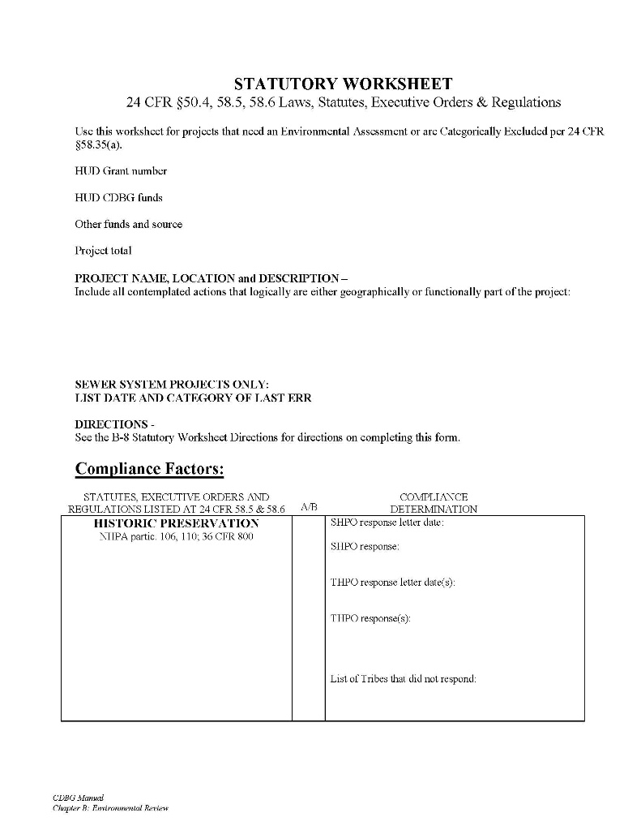
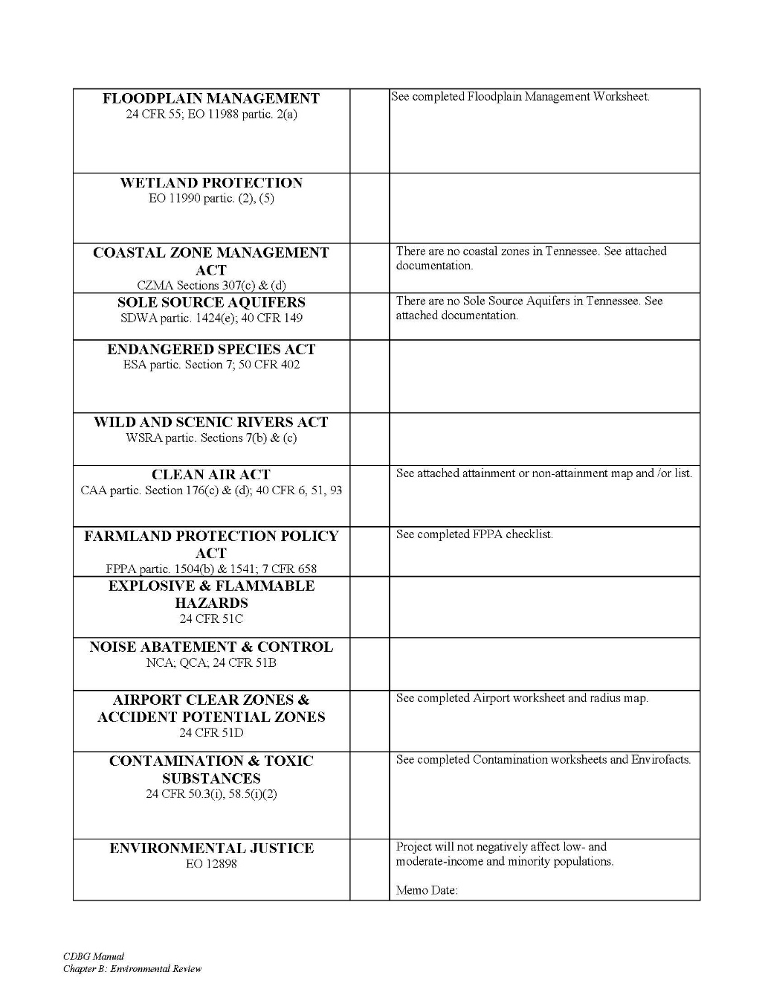
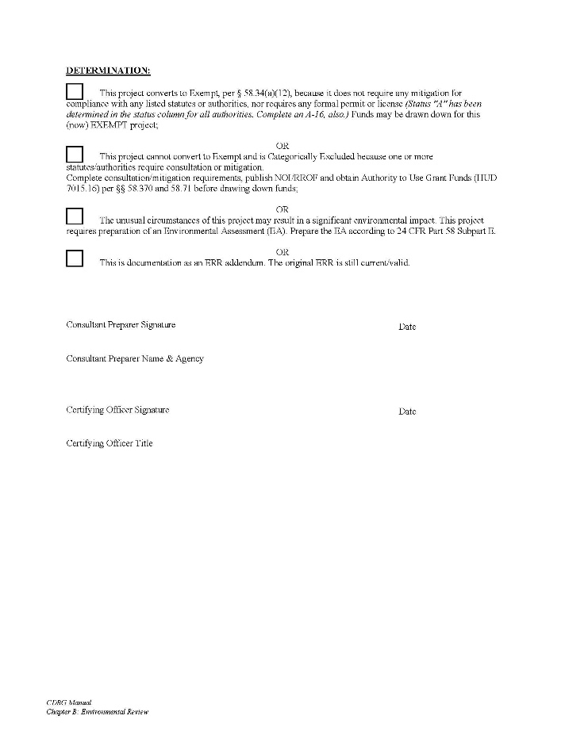
Statutory Worksheet

Slide 28
Statutory Worksheet
Use Exhibit B-8 Statutory Worksheet Directions and CDBG Manual for reference
In the final ERR, all Statutory Worksheet compliance documentation should appear after the Statutory Worksheet in the order of categories listed on the Statutory Worksheet
Statutory Worksheet must be complete before NOI-RROF or Concurrent Notice can be published.
  “Complete” means that tribes have been given the required 30 or 35-day response period, responses have been received from all required agencies, etc.
Notes:
Completed for both CEST and EA level – this is the bulk of the ERR. SHOW Statutory Worksheet in the B-2. SHOW B-8 Directions. ERR preparers should follow the B-8 Statutory Worksheet Directions very closely – this is a step-by-step guide for completing the worksheet and tells you the required items you will need to attach to document compliance for each category.

Slide 29
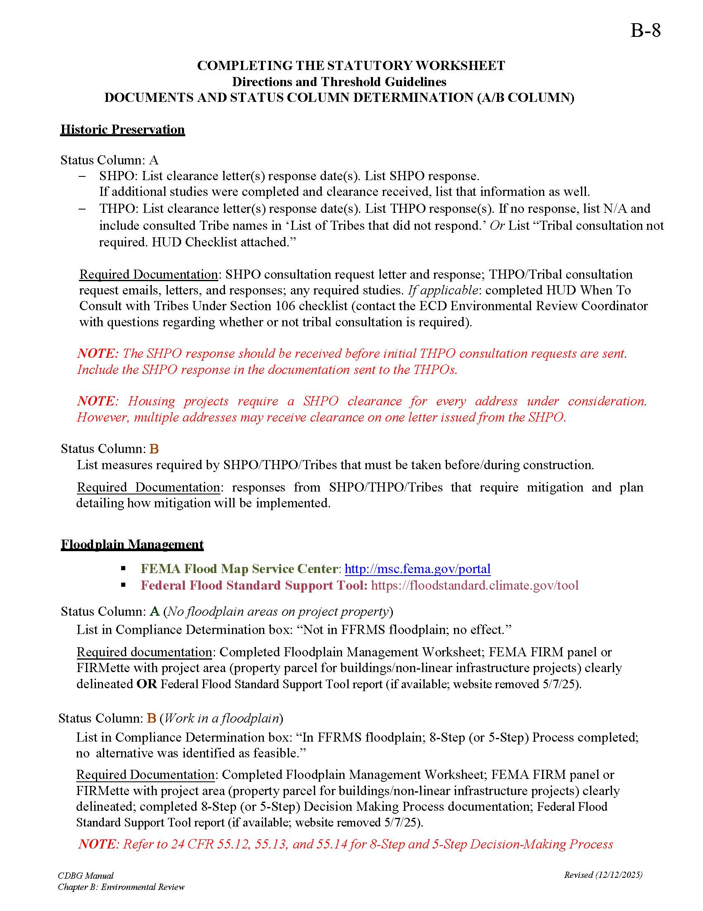
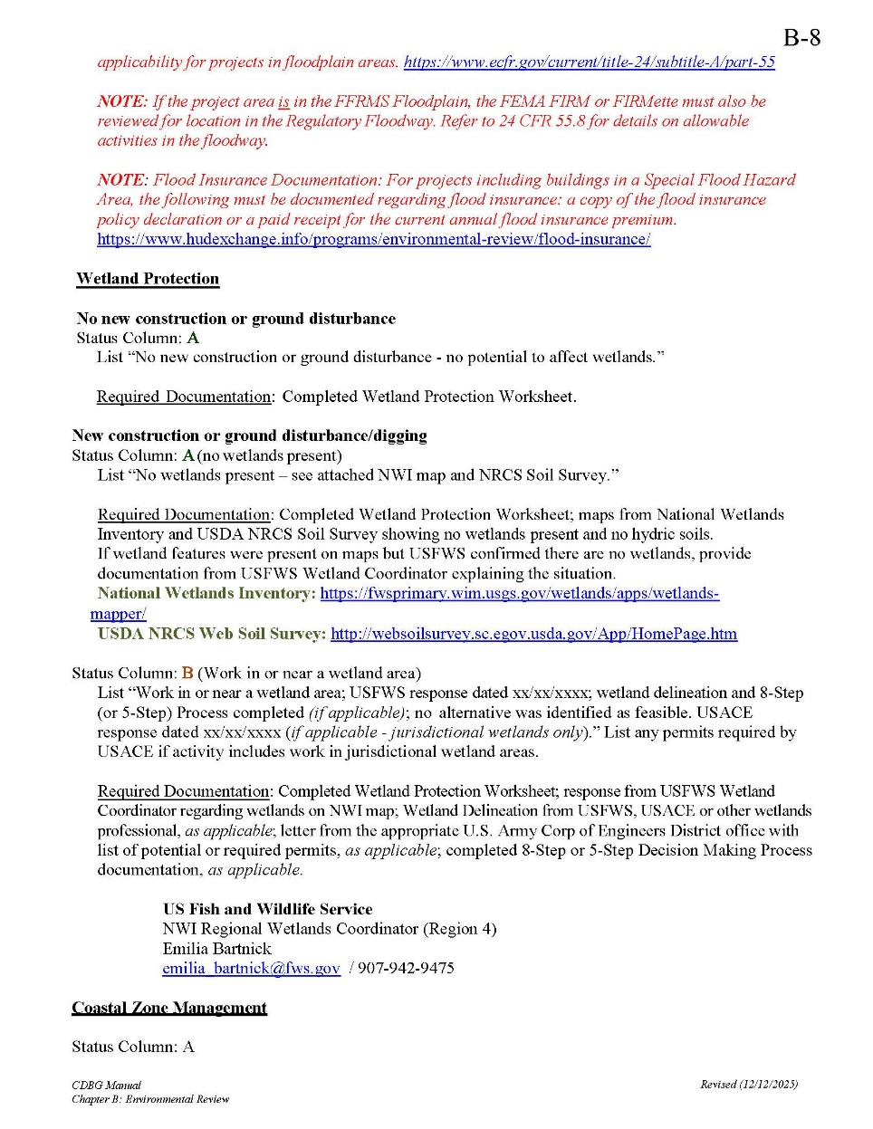
B-8 Statutory Worksheet Directions

Slide 30
Statutory Worksheet – Historic Preservation
Historic Preservation - State Historic Preservation Office (SHPO)
  Section 106 Review
Historic Preservation - Tribal Consultations
  Use B-6 Required Tribal Consultation by County and B-7 Tribal Consultation Process & Contacts as a guide
    Updates to THPOs and other tribal contacts
    Must use B-6 and B-7 updated versions for all 2025 regular round ERRs (and any ERR started after 12/12/25)
Complete SHPO consultation before sending tribal consultation requests (include SHPO response in initial emails/letters to tribes)
  Send consult request to all contacts listed for a particular tribe on the B-7; draft a separate letter to each contact
  Consult request letters must be on City/County letterhead
  Email consultation requests must be sent by City/County staff; email should be used if the B-7 states that the tribe prefers email contact
Notes:
Section 106 of the National Historic Preservation Act. Tribal consultations are one part of the ERR that, if done incorrectly at the beginning, can really delay your ERR approval (if consultations have to be redone).

Slide 31
Statutory Worksheet – Historic Preservation
HUD’s “When to Consult with Tribes Under Section 106” checklist is now part of our process (found on last page of B-7)
Remember: tribes must also be contacted every time there is a required publication (tribes are on the Distribution List). Distribution List letters can now be sent via email or via postal mail as hardcopies.
  EN-PR (Early Notice-Public Review)
  FN-PE (Final Notice-Public Explanation)
  Concurrent Notice or Notice of Intent to Request a Release of Funds
Notes:
SHOW B-7 to explain the HUD When to Consult checklist. STOP and ask for questions on tribal consultation process.

Slide 32
Statutory Worksheet – Floodplain Management
Floodplain Management
  24 CFR Part 55 – had major updates in 2024; review closely
  Floodplain Management Worksheet updated to reflect instructions on using FEMA FIRM panels/Firmettes to document FFRMS Floodplain (100-year or 500-year floodplain)
    Federal Flood Standard Support Tool no longer available to document FFRMS floodplain (may become available again in future)
  If in FFRMS floodplain, must also check FEMA FIRM / Firmette for location in the Regulatory Floodway)
    Entire property parcel must be delineated for building/non-linear infrastructure projects
  Local NFIP Coordinator response needed for any project including work in a floodplain
  8-Step (or modified 5-Step) Decision Making Process Required for most activities in the FFRMS Floodplain
    8-Step Decision Making Process Documentation forms included in B-2 and B-3 worksheets
Notes:
SHOW Floodplain Management Worksheet in B-2

Slide 33
Statutory Worksheet – Floodplain Management
Floodway
  Some limited activities are allowable in the regulatory floodway
    Review 24 CFR 55.8(a)(1)
  Check FEMA floodplain maps before submitting a CDBG application to avoid proposing projects on sites that contain a floodway
Flood Insurance
  required for buildings in a floodplain; must be FEMA/NFIP-compliant
  Review HUD Flood Insurance guidelines
Notes:
SHOW Exhibit B-14 – 55.12(c)(7) – explain language and criteria that must be met

Slide 34
Statutory Worksheet – Wetland Protection
Wetland Protection
  Consideration of wetlands required for any project with ground disturbance (including water/sewer rehab and street resurfacing)
  Wetland Protection Worksheet (in B-2 and B-3 Worksheets) walks you through the steps and requirements
  National Wetlands Inventory Map
  USDA NRCS Web Soil Survey
    If wetland areas or hydric soils are indicated, contact US Fish and Wildlife Service Wetland Inventory Coordinator for more information and next steps
    If jurisdictional wetlands are present, US Army Corps of Engineers must be consulted
  8-Step (or modified 5-Step) Decision Making Process Required for activities that will directly impact a wetland area
    Publish Early and Final floodplain notices (for 8-Step process) and send notices to Distribution List
    8-Step Decision Making Process Documentation forms included in B-2 and B-3 worksheets
Notes:
SHOW Wetland Protection Worksheet in B-2; explain new process for consulting with USFWS – they will likely direct ER preparers to consult with USACE (if jurisdictional wetlands are present). They also may say that data in the NWI mapper is outdated and that no wetlands are present, OR they may say that a wetland delineation is needed. In this case, a wetland professional would need to conduct a wetland delineation.

Slide 35
8-Step Decision Making Process
8-Step Decision Making Process
  8-Step Decision Making Process Documentation forms updated in 2024 to reflect updates to 24 CFR Part 55 (included in B-2 and B-3 worksheets)
    Publish Early and Final floodplain notices (required for 8-Step process) and send notices to Distribution List agencies
      Early and Final Notice templates updated in 2024 (included in B-2 and B-3 worksheets) – Always customize notice language to reflect the actual situation of the project (floodplain or wetland, etc.)
  A modified 5-Step Decision Making Process is applicable to some projects – this eliminates steps 2, 3, and 7 (2 and 7 are the public notices)
    Review 24 CFR 55.14 for 5-Step Process applicability
Note: your project engineer should assist with the answers to the questions in the 8-Step Decision Making Process – must be answered thoroughly and thoughtfully.

Slide 36
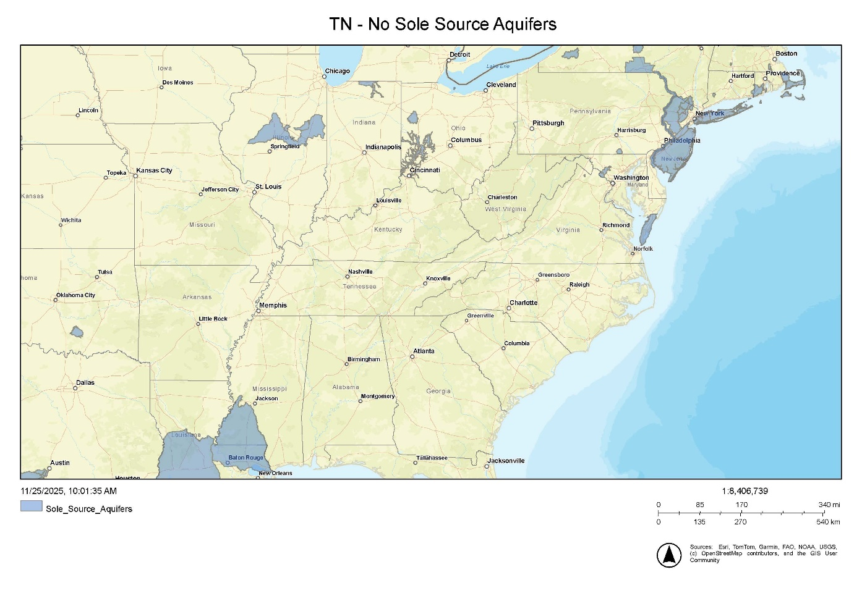
Statutory Worksheet – Sole Source Aquifers
Sole Source Aquifers – A map is now included in the B-2 and B-3 worksheets to serve as the backup documentation for this category (no further documentation needed)

Slide 37
Statutory Worksheet – Endangered Species Act
Endangered Species Act
  USFWS online review system – Self-Certification Process
    Must also include the email showing the Self-Certification package was sent to USFWS directly
  The USFWS “Clearance to Proceed with Projects” letter can be used for some (few) projects if they meet the listed criteria. A confirmation email from USFWS is needed to confirm compliance.
Notes:
SHOW USFWS project review page

Slide 38
Statutory Worksheet – Explosive and Flammable Hazards
Explosive and Flammable Hazards – worksheet language (question #1) updated to clarify when this part applies
Applicable to the following projects/activities:
  development, construction, rehabilitation, modernization or conversion of a building or site intended for residential, institutional, recreational, commercial, or industrial use
  Projects which will result in an increased number of people being exposed to hazardous operations by increasing residential densities, converting the type of use of a building to habitation, or making a vacant building habitable

Slide 39
Statutory Worksheet – Contamination & Toxic Substances
Contamination & Toxic Substances worksheets
  Envirofacts report
    Make sure all results are showing; defaults to 10 per page
    Include compliance reports (ECHO) for SEMS, ACRES, RAD sites, if applicable
  For buildings, HUD guidance must be followed for Lead-Based Paint, Asbestos
  Site Contamination Worksheet - Only fill out if a Phase 1 ESA was completed
  Radon Worksheet added in 2024 – needed for all projects involving buildings
Phase 1 Environmental Site Assessments (ESA)
  Required for:
    Non-residential property (commercial and public buildings, parks)
    Multi-family housing with 5 or more dwelling units
  24 CFR 58.5 (i) (2) states:
    “it is HUD policy that all properties that are being proposed for use in HUD programs be free of hazardous materials, contamination, toxic chemicals and gases, and radioactive substances, where a hazard could affect the health and safety of occupants or conflict with the intended utilization of the property.”
    “The environmental review of multifamily housing with five or more dwelling units (including leasing), or non-residential property, must include the evaluation of previous uses of the site or other evidence of contamination on or near the site, to ensure that the occupants of proposed sites are not adversely affected by any of the hazards listed in paragraph (i)(2)(i) of this section.”
Notes:
SHOW Contamination & Toxic Substances worksheets in B-2

Slide 40
Statutory Worksheet – Noise Abatement & Control
Noise Abatement & Control
  Only relevant for facilities with noise-sensitive uses (housing, childcare, nursing homes, hospitals, libraries, etc.)
  Review for the following:
    Highways within 1,000 feet
    Railroads within 3,000 feet
    Airports (civil or military) within 15 miles
  Complete the DNL calculation if any of the above are within those radii of the project site
  DNL Calculations over the 65-decibel limit: reach out to Allison for assistance determining allowable mitigation measures
  To obtain accurate highway traffic data for DNL calculations, you need access to the TDOT E-TRIMS system. Request access from the following:
        Irina Ponarovskaya - irina.ponarovskaya@tn.gov
        Randall Emilaire - randall.emilaire@tn.gov
    Reach out to Allison if you need assistance obtaining the correct traffic data from TDOT E-TRIMS
Notes:
SHOW DNL calculator? STOP and ask for any questions related to the Statutory Worksheet, new processes, B-8 Directions.

Slide 41
NEPA HUD EA Factors Checklist
Use Exhibit B-9 NEPA HUD EA Factors Checklist Directions for appropriate contacts and required documentation
  Updated contact info for TDEC Division of Water Resources
  Contact ECD for approval of any consultants not listed on the B-9
  Mayor is not an acceptable expert unless approved by ECD
Impact Codes are as follows:
  (1) Minor beneficial Impact
  (2) No impact anticipated
  (3) Minor Adverse Impact - may require mitigation
  (4) Significant or potentially significant impact requiring avoidance or modification which may require an Environmental Impact Statement
        Expert consulted should provide the numeric Impact Code
Notes:
SHOW the B-9 NEPA Checklist Directions

Slide 42
NEPA EA Factors Checklist*
Consultation processes for the following EA Factors:
  Environmental Justice
    Mayor or other listed organization from B-9 can provide Impact Code; Environmental Justice Memo from Statutory Worksheet may be used to document. (EPA EJ Screen report tool is no longer available)
  Vegetation – TDEC Environmental Review Tool (ERT)
    Must complete ERT training to access the system; upcoming trainings are listed here: https://tnstateparks.com/parks/events/division-of-natural-areas
    Self-Certification can be done by:
      ER preparer – best for projects on existing structures, interiors of buildings, occurring exclusively in mown lawns or ag fields where no rare plants are known from those habitat types, etc.
      Emailing ERT report to TDEC DNA (environmental.review@tn.gov) for review and self-certification by TDEC on behalf of ER preparer/DD staff (may be in the form of a concurrence letter)
      Environmental Consultant
    Further action may be required on some projects as indicated in the ERT report or by TDEC staff
  Wildlife – TWRA Env. Review Request Form
  Water Resources – new TDEC DWR contact info listed on B-9
*Reference: HUD Environmental Assessment Factors and Categories eGuide
Notes:
SHOW NEPA Checklist in B-2. SHOW EA factors on HUD eGuide?

Slide 43
Publications and Notices
Public Notices can be published in local newspaper OR on an appropriate local government website
  For web publication, include screenshot of first and last day of publication
Anytime a notice is published, a copy of the notice must be sent to all parties on the Distribution List.
  Distribution List is updated with new agency contacts (in B-2 and B-3)
Alternate option: Postings in public places (minimum 5 places)*:
  Photos of postings
  Locations of postings
  Start and end dates
  *Cannot post for floodplain projects
Early floodplain/wetland notice: published with 15-day comment period
Final floodplain/wetland notice: published with 7-day comment period
NOI/RROF (for CEST) published with 7-day comment period, posted for 10 days
Concurrent Notice (for EA) published with 15-day comment period, posted for 18 days
Use B-10 Comment Period Calendar Calculator to plan publication and comment period end dates.
  NOTE: the B-10 does not currently calculate for the public posting option, which has a longer comment period
Notes:
SHOW B-10 if not running to low on time

Slide 44
Reminders/Common Issues
Check with ECD if you have questions about which ERR level is needed
Use ERR Exhibits currently posted in the manual online (Chapter B) – submissions on old forms or using outdated contacts will not be accepted and will have to be redone
Project descriptions should be very detailed; explain exactly what is taking place (construction activities, etc.)
Project area must be clearly and accurately delineated on maps
Use the correct HUD Grant Number – entered on multiple pages of the ERR
Follow B-8 Statutory Worksheet Directions closely!
  use the provided compliance determination language
  Do not leave out required items listed
Complete SHPO consultation/receive response before sending initial tribal consultation requests
Initial tribal consultations - tribes must be given 30 days to respond if emailed / 35 days if postal mail – the Statutory Worksheet is not complete until that response window has passed

Slide 45
Reminders/Common Issues
Submit documents in order
  SHPO and THPO are attachments to the Statutory Worksheet; all Statutory Worksheet documentation should follow the Statutory Worksheet in the order listed
  Other documentation should be in the order listed on the ERR Checklist
Mitigation measures must be listed on narrative pages, NEPA, and 8-Step Decision Making Process documentation (if applicable)
All required agency responses must be received/all compliance documentation complete (Statutory Worksheet and NEPA Checklist) before publishing the NOI-RROF or Concurrent Notice
Use the B-10 Comment Period Calendar Calculator to determine comment period end dates for publications
Submit complete ERRs to your ECD project rep and cc Allison Fox
Request Extension letters before the submission deadline has passed (one-week window on submission deadline)

Slide 46
We’re here to help!
Our office will schedule ‘ERR troubleshooting’ sessions in the next couple of months
We can also conduct training sessions for your agency’s team to clarify processes or troubleshoot specific ERR issues
Please read CDBG Manual Chapter B narrative, review exhibits, and familiarize yourself with ERR forms and instructions before requesting additional training ☺
Notes:
May hold first ERR troubleshooting session around the beginning of March

Slide 47
Helpful Resources
TNECD CDBG Manual – Environmental Review Chapter
HUD Environmental Guidance for Tennessee
Consultation Resource Useful Web Links
HUD Environmental Review Orientation
HUD WISER Training Modules

Slide 48
Acquisition

Slide 49
Basic Requirements and Application
Must follow the Uniform Relocation Act (49 CFR Pat 24)
Applies to any activity that is funded, in whole or in part, with CDBG funds
Includes any acquisition of real property
  Land
  Easements
  Buildings
  Houses
Cannot begin acquisition until ERR is approved

Slide 50
URA Process
Inform property owner(s) of intention to acquire property
  Send a "Preliminary Acquisition Notice" to each property owner (Exhibit D-1)
  Include the booklet When a Public Agency Acquires Your Property (Exhibit D-2)
  Include the "Waiver of Rights and Benefits of the Uniform Relocation Assistance and Real Property Acquisition Policies of 1970" (Exhibit D-3)
    To be used when a property owner chooses to donate property
Consult with property owners to see who wishes to donate
  Collect “Waivers of Rights…” and record the acquisitions

Slide 51
URA Process
Property owners who choose not to donate may request a valuation of the property to be purchased
  Estimated property value $10,000 or greater requires appraisal and review appraisal to determine just compensation
  Estimated property value under $10,000 may request just compensation value without appraisal and review appraisal
If going through the appraisal process, two qualified professionals must be procured:
  The first to conduct the appraisal
  The second to conduct the review appraisal
If conducting an appraisal, the property owner must be provided with a copy of the Invitation to Accompany an Appraiser (Exhibit D-4)

Slide 52
URA Process
Provide a "Statement of the Basis for the Determination of Just Compensation“ to the property owner
Negotiate with property owner
  Settle on price
  Donate
  Refuse
Complete the settlement

Slide 53
Plans and Specifications

Slide 54
Plans and Specifications
Plans and specifications are to be submitted after approval of the Environmental Review
Plans and specifications must be approved by TNECD prior to bidding or procurement
TNECD documents may be added to, but not altered

Slide 55
Plans and Specifications - All
The following documents are included in all plans and specifications (construction and equipment):
  Advertisement for Bids
  Information for Bidders
  Acknowledgement Regarding Bidder SAM Registration
  Non-Boycott of Israel Certification
  Iran Divestment Act

Slide 56
Plans and Specifications - Construction
The following additional documents are included in all plans and specifications that include construction:
  Acknowledgement Regarding Bidder SAM Registration
  Certification of Bidder Regarding Equal Employment Opportunity
  Certification of Bidder Regarding Use of Female/Minority Subcontractors
  Certification of Bidder Regarding Section 3 and Segregated Facilities
  Certification of Subcontract Regarding Debarment, Suspension, Ineligibility, and Exclusion
  Certification by Proposed Subcontractor Regarding Equal Employment Opportunity
  Certification of Proposed Subcontractor Regarding Section 3 and Segregated Facilities
  Drug-Free Workplace Affidavit
  Statement of Compliance Certificate - Illegal Immigrants
  Certification of Compliance with the Build America, Buy America Act
  CDBG Contract General and Supplemental Conditions

Slide 57
Plans and Specifications – Additional Docs
The following documents are to be included with the plans and specifications in specific situations:
  Status of Land Acquisition document – needed whenever the project includes construction on land, within easements, rights-of-way, etc.
  Certification of Compliance with Accessibility Standards – needed when the project includes improvements or rehabilitation of public building
  Clearance of LOREC Notations for Plans and Specifications Approval – needed when the there are notations within the LOREC. Should include responses to all notations.

Slide 58
Plans and Specifications
Include all applicable forms, certifications, and affidavits
  Use Exhibit F-1 for construction projects
  Use Exhibit F-5 for equipment projects
  New certification included – Certification of Compliance with the Build America, Buy America Act
Check for brand names and equivalent language
Water & sewer plans and specs must be sent to TDEC for review

Slide 59
Plans and Specifications
Equipment with installation cost over 13% need to include Davis-Bacon language
  Rare cases
Plan to bid loose equipment as a package, not line item
Do not be too specific that it limits bidders
  Important for equipment like fire trucks and ambulances
Reminder: Review before submitting to ECD
  Three strike rule – If your ECD project manager catches three errors/problems, he/she can stop reviewing and return for corrections

Slide 60
Plans and Specifications – Bid Alternates
Consider bid alternates
  Additive
  Deductive
  Provides flexibility and limits chances of rebidding
Additive Alternates
  Start with a base amount and add items as funding permits
  Clearly specify the order in which items will be added
Deductive Alternates
  Start with a complete project and remove items as needed to bring the project in-line with funding
  Clearly specify the order in which items will be removed
  Be careful to not reduce the scope

Slide 61
Plans and Specifications
Statewide Contract:
  Documentation of listing on Active Statewide Contract list
  Request letter from mayor
  Submitted to ECD prior to contacting vendor
Cooperative Agreement:
  Request letter from mayor
  Documentation from the other governmental entity or service
  If using a service/platform, documentation the method of procurement is compliant with the State of TN
  Adopted resolution agreeing to the terms of the master agreement of the cooperative purchase service/platform
  Must comply with local procurement policies

Slide 62
Build America,
Buy America (BABA)

Slide 63
Build America, Buy America (BABA)
BABA requires any “infrastructure project” funded by any “Federal Financial Assistance” (FFA) apply a domestic content procurement preference, meaning that all iron, steel, manufactured products, and construction materials used in the infrastructure project have been produced in the United States, unless the awarding agency has issued a waiver of this requirement.
Implemented differently by each federal funding agency
HUD BABA website

Slide 64
BABA – Phased Implementation
BABA implementation for CDBG is phased
  Specifically-listed construction materials:
    non-ferrous metals;
    lumber;
    plastic and polymerbased pipe and tube
 | Iron and Steel | Construction Materials – Specifically Listed | Construction Materials – Not Listed | Manufactured Products
CDBG | Grants under Program Year 2023 | Grants under Program Year 2024 | Grants under Program Year 2025 | Grants under Program Year 2025
CDBG-RHP | Grants under Program Year 2023 | Grants under Program Year 2024 | Grants under Program Year 2025 | Grants under Program Year 2025
CDBG-CV | N/A | N/A | N/A | N/A
CDBG-DR | N/A | N/A | N/A | N/A

Slide 65
BABA – Specifically-listed Construction Materials
Non-ferrous metals – All manufacturing processes, from initial smelting or melting through final shaping, coating, and assembly
Lumber – All manufacturing processes, from initial debarking through treatment and planing
Plastic and polymer-based composite building materials, pipe, and tube – All manufacturing processes, from initial combination of constituent plastic or polymer-based inputs, or, where applicable, constituent composite materials, until the item is in its final form

Slide 66
BABA – Other Construction Materials
Glass – All manufacturing processes, from initial batching and melting of raw materials through annealing, cooling, and cutting
Fiber optic cable (including drop cable) – All manufacturing processes, from the initial ribboning (if applicable), through buffering, fiber stranding and jacketing
Optical fiber – All manufacturing processes, from the initial preform fabrication stage through the completion of the draw

Slide 67
BABA – Other Construction Materials
Drywall – All manufacturing processes, from initial blending of mined or synthetic gypsum plaster and additives through cutting and drying of sandwiched panels
Engineered wood – All manufacturing processes from the initial combination of constituent materials until the wood product is in its final form
Other plastic and polymerbased products– All manufacturing processes, from initial combination of constituent plastic or polymer-based inputs, or, where applicable, constituent composite materials, until the item is in its final form

Slide 68
BABA – General and Specific Waivers
General Waivers
  Small grants – the total project cost is less than $250,000
  De Minimis – a cumulative total of no more than 5% of the total cost of the iron, steel, manufactured products, and construction materials, up to a maximum of $1 million
  Exigent Circumstances – urgent need or a threat to life, safety, or property of residents and the community
Specific Waivers
  Public Interest – the use of the American made product would be inconsistent with the public interest
  Non-Availability – the product needed is not produced in the United States in sufficient quantities or of a satisfactory quality
  Unreasonable Cost – inclusion of the product produced in the US will increase the cost of the overall project by more than 25%

Slide 69
BABA – Project Specific Waivers
Request for a project specific waiver must be submitted using the Build America, Buy America Waiver Request form (Exhibit M-1)
Project specific waivers will require review by HUD and the Made in America Office
Expect at least 6 weeks for specific waiver reviews
Design projects expecting not to get specific waivers

Slide 70
BABA Compliance
The BABA Applicability Checklist (Exhibit M-2) is available to assist in determining BABA applicability
Contractors should submit the BABA Covered Materials and Manufactured Goods List (Exhibit M-3) to the local administrator at the following intervals of the project:
  Start of construction
  Addition of new materials (typically coinciding with a change order)
  With the submission of final invoice
This will be reviewed at monitoring

Slide 71
Bidding and Procurement

Slide 72
Levels of Procurement
Formal Bidding
Informal Purchases
Micro-purchases
Statewide Contract
Cooperative Purchase
Sole Source
Proposals

Slide 73
Procurement Requirements
Procurements made as part of a CDBG project must meet federal, state, and local procurement requirements.
When requirements conflict, the strictest prevails
Engage the local government procurement officer early
Cost plus percentage of cost contracts are specifically prohibited if CDBG funds are involved

Slide 74
Procurement Requirements
Federal procurement requirements are detailed at 2 CFR 200.320
State county procurements requirements are detailed at TCA § 12-2-201 et seq.

Slide 75
Formal Bidding
Bid opening must be advertised in a newspaper
  Does not have to be daily
  Consider other actions to solicit bidders
  14 days minimum between advertisement and bid opening
Consider pre-bid meeting for complex projects
Check the wage determinations 10 days (or less) prior to bid opening
  Be sure to include proof
  Addendum must be issued if determinations have changed
All addenda must be approved by ECD
  Submit at least 4 days prior to bid opening
  State law requires 48 hours notice to bidders

Slide 76
Formal Bidding - Participation
Must submit to GoBID portal for construction
  Decide who will submit. Typically submitted by the engineer.
Equipment projects must document how DBEs are solicited and encouraged to bid
  Document direct solicitation of DBEs or save a copy of a DBE database search that returned ‘no results’ for the equipment type you are procuring
Think of ways to encourage participation from bidders
  Utilize plans rooms
  Industry networks (Dodge Report)
  Keep a catalogue of potential bidders from previous projects

Slide 77
Bid Opening
The administrator should attend and coordinate bid openings
Keep a sign-in sheet of attendees and minutes
Submitted bids are kept sealed and opened one at a time, publicly at the bid opening
  Bids submissions that do not meet the submission requirements in the plans and specs shall not be opened and are disallowed
Announce who is the apparent low bidder, contingent on review of the entire bid proposal.

Slide 78
Informal Purchases
Purchases that fall under the threshold for formal bidding may use the informal purchase method.
The administrator will assist the grantee in obtaining at least three (3) quotes for goods or services.
Each of the quotes must be recorded.
The selected vendor must still agree to sign all applicable certifications and affidavits.
Must submit the local government procurement policy

Slide 79
Micropurchases
In rare cases, purchases that fall under the threshold for informal purchase may use the micropurchase method.
Quotes are not required, but grantees are encouraged to shop for the best price.
The selected vendor must still agree to sign all applicable certifications and affidavits.
Must submit the local government procurement policy.
Include the list of items intending to be purchased.

Slide 80
Statewide Contract Purchases
Local government grantees can take advantage of the statewide contracts that have already been procured by the State of Tennessee.
List of active statewide contracts
Check the usage instructions
The selected vendor must still agree to sign all applicable certifications and affidavits.
Inform your project manager if using this method.

Slide 81
Cooperative Agreement Purchase
Under T.C.A. § 12-3-1205 local governments are allowed to utilize cooperative purchases agreements with other governments inside or outside the state.
  Construction services are only allowed in-state
Typically used for equipment
Adopted resolution agreeing to the terms of the master agreement of the cooperative purchase service/platform
Include the documentation from the cooperative that they comply with TN procurement requirements

Slide 82
Cooperative Agreement Purchase
Must comply with local procurement policies
The selected vendor must still agree to sign all applicable certifications and affidavits.
Inform your project manager if using this method.

Slide 83
Sole Source
May be allowed in very special circumstances
  Single source of availability
  Compatibility
The selected vendor must still agree to sign all applicable certifications and affidavits.
Inform your project manager if using this method.
For equipment, include proof the vendor is the only one covering that area.

Slide 84
Proposals
Used when procuring professional services
Qualification and experience is most important. Price must be a factor, but grantee may determine weight.
  Price may be omitted from A/E proposals only
  2 CFR 200.320
Be sure proposals and reviewed, scored and documented
Inform your project manager if using this method.

Slide 85
Recommendations for Bid Award
If recommendation comes from engineer, letter from mayor must be included (or adopted resolution if community requires a resolution)
All executed certifications and affidavits from bidder must be included
If local procurement policy requires council/commission approval, minutes must be included
Bid advertisement with the date of ad run must be included
Minutes of bid opening must be included

Slide 86
Recommendations for Bid Award
If low bidder is not selected, justification must be included
  Justification must be compelling. Does not guarantee TNECD approval
  Should include a letter/statement from the attorney or procurement officer
If selected bid exceeds budget amount, resolution for additional funding must be included. Resolution should note match amount and overage amount.
If only one bidder submits and you wish to accept the bid, the following must be included:
  Efforts to solicit bids
  Interest from potential bidders
  Justification why rebidding with additional efforts or changes to the plans and specs won’t result in increased competition

Slide 87
Recommendations for Bid Award
Any potential bidders must be registered on SAM.gov and have a SAM number (UEI).
Should a low bidder not be SAM registered, then their bid may be deemed non-compliant, and the next lowest bidder can be recommended.
UEI numbers must have Active status, not just Assigned

Slide 88
Recommendations for Bid Award
If performing multiple procurement and bidding rounds of various methods and types, please use a tracking form to assist with tracking and monitoring purposes. It should include:
  Procurement Type – Construction or Equipment
  If Equipment – Equipment unit cost
  Equipment Procurement Method – Formal, Informal, Cooperative Agreement, State Contract, Micro-purchase
  Awarded contractor or vendor
  Award amount
Said tracking form would "mirror" Contractor/Sub-Contractor Activity Report
Will be reviewed during monitoring

Slide 89
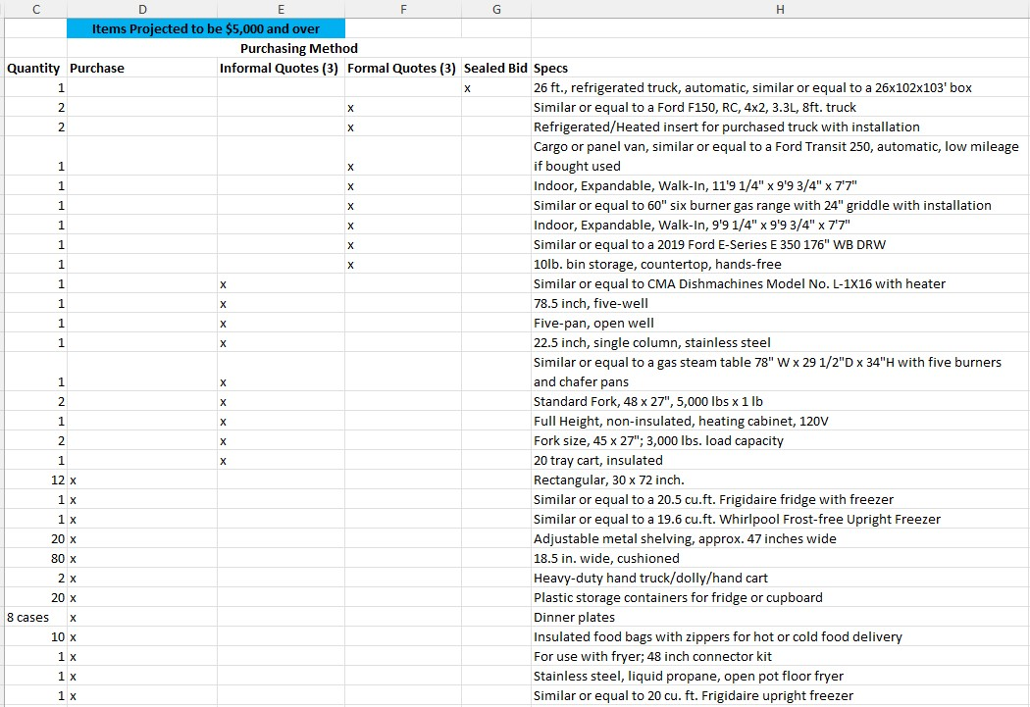
Tracking Log Example

Slide 90
Construction and Labor

Slide 91
Pre-Construction Conference
All construction projects should conduct a pre-construction conference prior to the start of construction
Typically, this is when the contract is signed
All details and of roles individuals should be discussed

Slide 92
Pre-Construction Conference - Expectations
Clearly explain expectations and requirements to contractors
  Davis-Bacon and Labor Requirements
    Weekly certified payrolls
    Submission of the Project Wage Rate and Section 3 Classification form (Exhibit I-1)
    Employee Interviews will be conducted by the administrator
    Additional wage classifications
    Job site posters
  Section 3 Requirements
  BABA Requirements
  Change Order Process
  Invoicing Process (payment delays based on submission date)
  Penalties and Damages

Slide 93
Start of Construction
Submit Notice of Start of Construction to ECD once date is set. Link: Notice of Start of Construction
Include initial Contract/Subcontract Activity Report with Notice of Start of Construction. Link: Form HUD-2516

Slide 94
Contractor/Subcontractor Activity Report
Contractor/Subcontractor Activity Report
  Submit to your TNECD project manager
  Submit with Notice of Start of Construction or when equipment order is placed
  Submit updated forms anytime a new contractor or sub is included
  Make sure you are using the CPD codes, not housing (1-3)
  Required for all CDBG projects (including equipment)
  Updated copies may be requested at time of monitoring
  Will require a final report with closeout submission

Slide 95
Contractor/Subcontractor Activity Report
Grant/Project Number 7a.
  5 digit contract number
Amount of Contract or Subcontract 7b.
  Amount of the awarded contracts
  Do not reduce subcontracts from prime
  Do not revise with change orders
Type of Trade Codes 7c.
  1 = New Construction
  2 = Education/Training
  3 = Other (This will include professional services)
Administration and Engineering are prime contracts
Contractor ID = FEIN

Slide 96
Change Orders
We allow increases work by more than 20% if the attorney provides a letter
  There will still need to be scope changes for a decrease in work of 20% or more
Change orders cannot be used for cost increases, only quantities and time
Justification/explanation from engineer must be included
  Letter of concurrence from mayor included
Adjustments to professional services require approval
  We are still having some trouble here

Slide 97
Davis-Bacon and Labor Requirements
Interview employees early in the project to catch problems early
  At least once a month, minimum
Get enough interviews to cover all wage classifications used
Make sure the employee interviews and payrolls match the job classification
Review the first few payrolls CLOSELY and fix the problems early on – check for any inconsistencies and errors

Slide 98
Davis-Bacon and Labor Requirements
Information on these documents should be consistent:
  Project Wage Rate and Section 3 Classification form
  Certified payrolls
  Employee interviews
All required posters and applicable wage decision must be clearly posted at the job site
  Will result in a finding at monitoring if not

Slide 99
Additional Wage Classification Requests
Submit requests to your TNECD project manager before work is done, as soon after contracting as you can
DOL at times takes 2-3 months to respond to requests
Things to consider
  Communicate with contractors about reasonableness
  Make sure requests include justification
  Other classifications don’t always work as justification
  If the additional classification is a skill position, use a published skilled rate as a basis; DOL will

Slide 100
Section 3

Slide 101
Section 3 - Applicability
24 CFR 75.3
New Section 3 rule applies to 2021 and later grants
Applies to only to construction projects with HUD assistance over $200,000
Does not apply to:
  Contracts for materials
  Contracts for professional services
  Procurement of equipment not related to housing rehabilitation, housing construction, or other public facilities construction, including fire trucks, ambulances, etc.

Slide 102
Section 3 Worker
A Section 3 Worker is any worker who currently fits, or when hired within the past five years fit, at least one of the following categories, as documented:
  The worker is employed by a Section 3 business; or
  The worker’s income for the previous or annualized calendar year is below the income limit established by HUD (the worker is either low- or very-low income);
  The worker is a YouthBuild participant.

Slide 103
Targeted Section 3 Worker
A Targeted Section 3 Worker is any worker who currently fits, or when hired within the past five years fit, at least one of the following categories, as documented:
  The worker is employed by a Section 3 business; or
  Low- or very low-income workers residing within a one-mile radius of the Section 3 project. If fewer than 5,000 people live within that one-mile radius, the circle may be expanded outward until that population is reached or the neighborhood of the project, as defined; or
  The worker is a YouthBuild participant.

Slide 104
Section 3 Worker Designations
All Targeted Section 3 Workers also meet the definition of Section 3 Workers.

Slide 105
Section 3 Benchmarks
Section 3 Workers = 25% of total labor hours
Targeted Section 3 Workers = 5% of total labor hours
Any labor hours counted toward the total for Targeted Section 3 Workers will also count toward the total for Section 3 Workers.

Slide 106
Determining Section 3 Worker Status
  The status workers on Section 3 projects can be determined using the following methods.
Worker income self-certification – the use of certification forms provided to contractors and subcontractors working on the project. Each worker on the project must complete the provided certification form to be kept in the grant record for reference when tracking and aggregating labor hours worked.
  Section 3 Worker Certification (Exhibit L-1)
Worker is employed by a Section 3 Business Concern – The contractor or subcontractor is able to provide documentation that it qualifies as a Section 3 Business Concern. All employees of a qualifying business will be considered Section 3 workers.

Slide 107
Determining Section 3 Worker Status
Worker is a Youthbuild participant – Verifiable documentation must be provided by the worker or the employer showing the worker is participating in a Youthbuild program.
* Documentation submitted by employers should only contain employee names, state and county of residence, annual income, and a certifying signature and date. Do not include any information such as social security numbers or bank account information.

Slide 108
Section 3 Business Concern
The definition of a Section 3 Business Concern has been changed that a qualifying business must meet one of the following criteria, documented within the past 6 months:
  The business is at least 51 percent owned and controlled by low- or very low-income persons
  At least 75 percent of the labor hours performed for the business over the prior three-month period are performed by Section 3 workers
  The business is at least 51 percent owned and controlled by current public housing residents or residents who currently live in Section 8-assisted housing
The Section 3 Business Self-Certification (Exhibit L-2), and necessary backup documentation must be submitted by the qualifying business.

Slide 109
Subrecipient/Grantee Responsibilities
Establish and maintain a list of resources and organizations that offer training and employment opportunities in the area.
  Temp services
  Jobs centers
  Youthbuild programs
  Etc.
Maintain Section 3 tracking
Make TNECD aware of Section 3 Businesses in your area.
Make contractors and subs aware of Section 3 at the pre-construction conference.

Slide 110
Subrecipient/Grantee Responsibilities
Monitor contractors and subcontractors for Section 3 compliance.
Make best efforts to meet Section 3 and Targeted Section 3 Worker benchmarks.
Report on efforts if benchmarks are not met.
Establishing the geography of the Targeted Section 3 Worker area if fewer then 5,000 people live within a 1-mile radius of the project area.
(Usually this will be the community.)

Slide 111
Contractor Responsibilities
Ensure subcontractors are aware of Section 3 requirements and responsibilities.
Maintain and provide a list of permanent employees working on the Section 3 project who were hired within the last 5 years and their Section 3 status. This will be completed as part of the Project Wage Rate and Section 3 Classification form (Exhibit I-1) .
Make a best effort to hire Section 3 or Targeted Section 3 Workers when new hires are necessary.

Slide 112
Reporting
Subrecipients are required to report the following at project closeout:
  The total number of labor hours worked
  The total number of labor hours worked by Section 3 workers
  The total number of labor hours worked by Targeted Section 3 workers
  The percentage of labor hours worked by Section 3 workers
  The percentage of labor hours worked by Targeted Section 3 workers
  If benchmarks are unmet, qualitative efforts and explanation of those efforts

Slide 113
Reporting
The Section 3 Labor Hours Tracking Form (Exhibit L-4) has been provided simplify tracking of labor hours a best we can.
Labor hours can be verified using weekly payrolls and the Project Wage Rate and Section 3 Classification form (Exhibit I-1).
A complete and accurate I-1 form for each contractor and subcontractor is essential.

Slide 114
Financial Management

Slide 115
Invoicing
The grant invoice template will be sent from ecd.tefmsadmin@tn.gov after the grant contract is fully executed
Invoices should be submitted every 1 to 3 months
Submit to ECD.Invoices@tn.gov
Typically takes 30 days to review and process (if everything is correct)

Slide 116
Invoice Template
Four tabs in Excel workbook
  Grant Budget
  Invoice
  Backup Detail
  Instructions
Data can only be entered into blue cells
Read the instructions
If you are unsure, ask you TNECD project manager

Slide 117
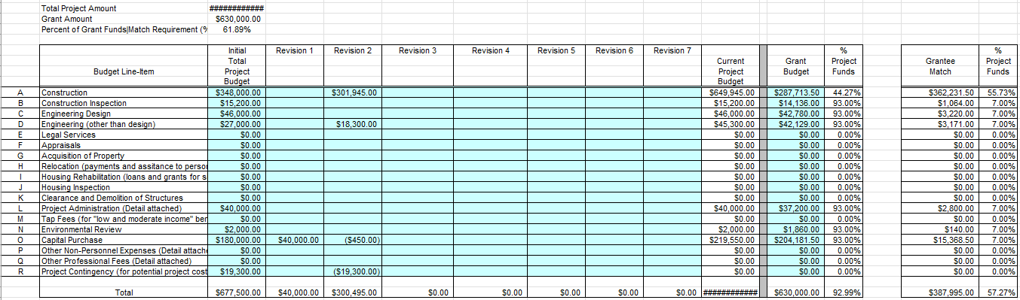
Invoice Template – Grant Budget
Tracks budget over time to include revisions
Adjusts line-item match accordingly

Slide 118
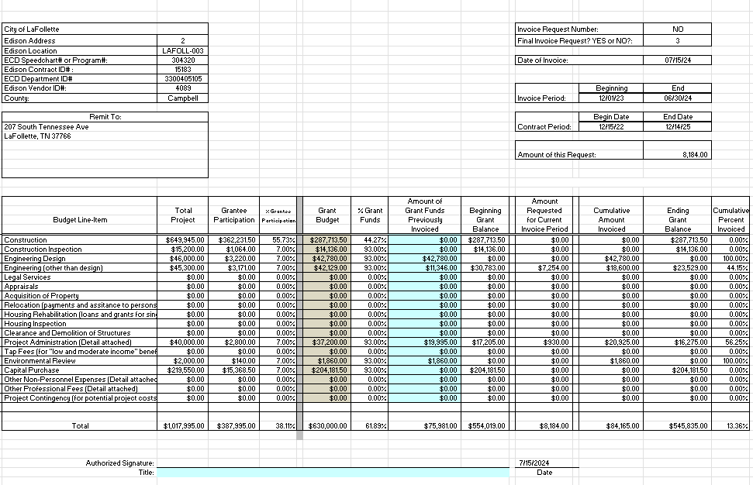
Invoice Template – Invoice

Slide 119
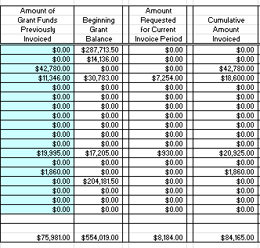
Invoice Template – Invoice
1*
2
3
This should be the total amount of grant funds previously invoiced for each line-item. Refer to the Cumulative Amounts Invoiced from the previous invoice.
These amounts will come from the Backup Detail tab.
The sum of the Previous Amount Invoiced and the Current Amount Invoiced.
* Double check these amounts. Errors have cumulative impacts

Slide 120
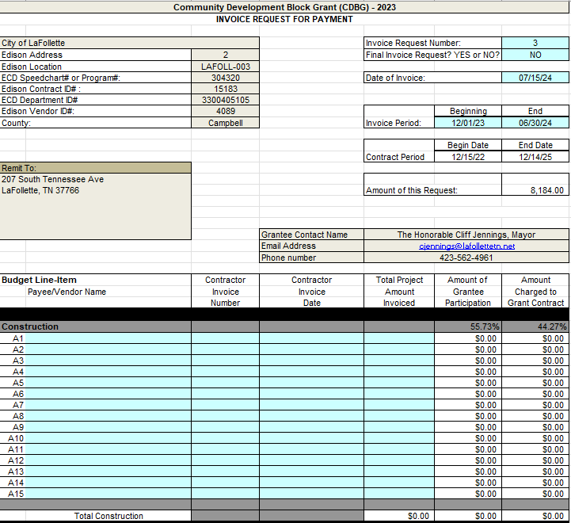
Invoice Template – Backup Detail
1
Enter the invoice number and if it is the final invoice.
Enter the date of the invoice. Must be on or after the date of the End of the Invoice Period.
Enter the Beginning and End dates of all invoices include in the request for payment.
2
3

Slide 121
Invoice Template – Backup Detail
1
Enter the vendor/ contractor on the included invoice(s).
Enter the invoice number(s) on the included invoice(s).
Enter the date(s) of the of the included invoice(s).
Enter the total amount(s) of the included invoice(s).
2
3
5
4
6
7

Slide 122
Invoice Template – Additional Guidance
Make sure to include the line-item number on the Backup Detail tab on the corresponding included invoice.
Make sure included invoice dates all fall within the Invoice Period.
Make sure included invoice dates all fall within the Contract Period.
If the grantee has already paid for the service or good, a copy of proof of payment is included.

Slide 123
Invoice Template – Backup Documentation
Copies and scans must be legible (amounts, dates, names, etc.).
Backup documentation should always be in order and consistent with the Backup Detail tab.
Professional services invoices must include a description of the work performed.
Overall line-item invoicing should be consistent with the project timeline. (ie. Don’t invoice 75% of Grant Admin if the project hasn’t been bid yet.)

Slide 124
Budget Revisions
Submit anytime a budget line-item is adjusted
  Bid Awards
  Change Orders
  Changes in professional fees
Submit to your TNECD project manager at the same time as the bid award, change order, etc.
The Budget Revision Template (Exhibit A-3) must be used.

Slide 125
Budget Revisions
Only enter data in blue cells.
Each line item must contain at least the minimum required match percentage.
Moving funds to a $0.00 line-item will require a contract amendment instead of a simple budget revision

Slide 126
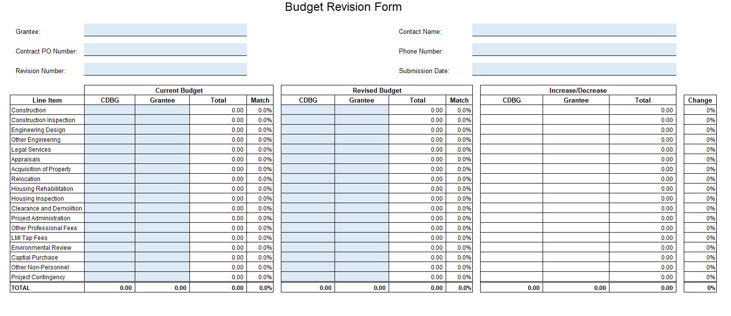
Budget Revision Template
Enter the Current Budget and the Revised Budget to see the changes.
Double check your amounts. These will be reflected in an updated Invoice Template.
Make sure the amount of Total Amount of Grant Funds do not change.

Slide 127
Grant Monitoring

Slide 128
Monitoring
Generally, set at 50% construction completion or equipment delivery
  Request earlier to give time to set monitoring
  Make sure enough employee interviews have been conducted
  Make sure Fair Housing activity is complete
Davis-Bacon is the biggest challenge, pay careful attention here
  Labor findings generally take the longest to resolve
Make sure to review grant documents before submitting for monitoring.
  Too many times we have projects submitted for monitoring then pushed out because the administrator is not ready.

Slide 129
Monitoring
Submit requests for monitoring online
  Link: CDBG Monitoring Request Form
  Submit requested monitoring documentation to the SharedDrive one week prior to monitoring date. This gives ECD staff time to review in advance.
Webform must be completed and documents submitted at least one week prior to monitoring appointment
  Link: CDBG Electronic Monitoring
Review the monitoring workbooks so you know what we are looking at.
  Sample Monitoring Workbook (Exhibit K-1)
  Sample Labor Monitoring Checklist (Exhibit K-2)

Slide 130
Monitoring
For construction projects, please have Section 3 documentation and Section 3 Labour Hours Tracking Form current. (CDBG Manual: Chapter L)
Grantee (City/County) should have copies of all documents on file.
  City Hall
  County Courthouse
If requested, please provide TAS surveys and have them ready for review.
For construction projects, take pictures of work progress during employee interviews.

Slide 131
Monitoring
Should you experience problems with submitting documentation to the SharedDrive for an electronic monitoring, please let TNECD staff know immediately.
Be mindful of monitoring timeline. TNECD staff receives monitoring assignments on the 5th of every month.
TNECD will provide grantees 7 business days after monitoring date to submit missing documentation before report letter is issued.
Notes:
Can invoice maximum of 80% of construction line item prior to monitoring – new rule starting implementation January 2026

Slide 132
Monitoring
Final RFP cannot be processed until monitoring is complete. (all documentation received, and any findings addressed)
We will begin withholding invoices that exceed 80% of construction if monitoring is not yet complete.
Notes:
Can invoice maximum of 80% of construction line item prior to monitoring – new rule starting implementation January 2026

Slide 133
Grant Closeout

Slide 134
Grant Closeout
The following items must be complete to trigger closeout procedures:
  Completion of construction or delivery of equipment
  Release of lien by the contractor (construction)
  Notice of Completion run in the local newspaper (construction)
  Monitoring is completed and any findings are cleared
  Final request for payment has been submitted
  Closeout public hearing has been held
Link: CDBG Closeout Report
  Be sure to select Closeout Report

Slide 135
Closeout Public Hearing
Closeout public hearings should be held within 30 days of the end of construction
Advertisement must run in the local newspaper at least 14 days prior to public hearing
Items to be addressed at the public hearing:
  The project as completed versus application
  Final cost of the project as completed
  Note of any significant adjustments
  Allow the public to voice and questions or concerns
Collect signatures of attendees and keep minutes

Slide 136
Additional Grant Administration

Slide 137
Contract Amendments
Reasons to amend a contract
  Extension of contract period
  Change in scope
  Budget adjustment to zero-dollar line items
Contract Extension
  Request contract extension using the new online form. Select the “Contract Amendment” tab on our Grant Administration page.
  Include the current budget
  Submit at least 90 days prior to contract expiration

Slide 138
Monthly and Annual Reports
Monthly Status Reports are required to be submitted by the 25th of each month
Make sure the form fields are being updated as needed
Annual Reports due at the end of December
Will take the place of the December monthly report
Link: CDBG Annual Report
  Be sure to select Annual Report
Performance measures should match those in application

Slide 139
Grantee Recordkeeping
Full grant files must be kept by the grantee at all times
Grant files must be kept by the grantee 5 years after the closeout date of the grant
Consider keeping electronic records that are accessible by both the grantee and grant administration agency
TNECD only accepts electronic record submissions

Slide 140
Contact Information
Kent Archer kent.archer@tn.gov 615-354-3591
Lynn Tutor p.lynn.tutor@tn.gov 615-674-0175
Allison Fox allison.fox@tn.gov 615-306-0539
Kayla Baxter kayla.baxter@tn.gov 615-308-3601
Lea Thomason lea.Thomason@tn.gov 615-517-8531
Tracey Davis tracey.l.davis@tn.gov 615-878-1896
Jill White (ARC) jill.white@tn.gov 615-981-7884
Lindsay Gainous lindsay.gainous@tn.gov 615-585-1533

Slide 141
Kent Archer
(615) 354-3591
kent.archer@tn.gov

