Slide 1
CDBG Application Workshop for Application Preparers
2026 Regular Round
December 16, 2025

Slide 2
Program Staff
Brooxie Carlton
Assistant Commissioner
Rachel Powers
Deputy Assistant Commissioner
Kent Archer
Director of Community Infrastructure
Lynn Tutor
Assistant Director of Community Infrastructure
Tracey Davis
CDBG Project Manager
Allison Fox
CDBG Project Manager
Kayla Baxter
CDBG Project Manager
Lea Thomason
CDBG Project Manager
Lindsay Gainous
ARC Program Coordinator

Slide 3
Schedule
Public Meetings held by February 6, 2026
Final change orders due February 27, 2026
Final RFPs due March 13, 2026
Closeouts due March 13, 2026
Applications March 20, 2026
Account for holidays
  Martin Luther King Jr. Day
  Presidents Day

Slide 4
Changes for 2026
Revised MSF tab in jurisdiction workbook
  Introducing flags to help catch errors
  Will collect more data
  More consistency
Jurisdiction workbook will be able to account for census tracts and block groups
Target area survey form layout adjustments

Slide 5
Recent Changes that Remain
Water and Sewer System applications limited to 2,500 residential connections and fewer
  No large and small population for system applications
  This will be the last year
Adjust scale for max funding for public health and safety
  Make construction and non-construction competitive
  Adjust non-construction to $1 million scale for scoring
Reintroduce sewer line extensions.
  Water lines and sewer lines will compete in the same category

Slide 6
Process
Online application in SmartSimple
Working on application now
Jurisdiction calculations are in Excel again
Use this and the Application Notices (to be published in the coming weeks) as a guide
NOTE: If any information is inconsistent, the information in the Application Notices will supersede.

Slide 7
Project Selection

Slide 8
Considerations for Project Selection
Environmental Review
  All acquisition and construction activities, except non-linear infrastructure require a Phase 1 ESA or Transaction Screen
  Review the Flood Maps (https://msc.fema.gov/portal/home)
  Take a quick look at EnviroFacts (https://enviro.epa.gov)
Scoring
  If an applicant has a low Community Need score is the project strong enough and/or serve enough people to offset?
Other Funding Included
  If other State/Federal funds are included, what are the requirements and timelines?

Slide 9
Considerations for Project Selection
Other Funding Available
  Is this the best project for this funding? What else is available?
Timeline
  What is the construction forecast? How will this impact eligibility if funded?
Build America Buy America (BABA)
  Will be expanding beyond iron and steel to other construction materials
  More guidance to come

Slide 10
Public Meetings

Slide 11
Public Meetings
At least 1 advertisement for the application meeting, at least 14 days before the meeting
Should be a display ad (stands out)
  Submit a copy of the ad. Affidavits do not take the place of the ad
Should be in the legal section if possible
Include statement of non-discrimination
Must be able to document other methods of outreach and notice

Slide 12
Public Meetings
The following must be presented at a minimum
  CDBG National Objectives
  Eligible project categories
  Funding maximum for construction and non-construction projects
  Minimum match requirement of the local government
  Any projects that local governments is considering for application
  A request for feedback from the public
  A request for any additional project considerations from the public
  Ample time for the public to voice any other concerns or questions

Slide 13
Public Meetings
Public meetings are required to be in-person
  May also stream broadcast virtual
Make sure at least one person from the community attends
Schedule to maximize participation
Minutes
  You must document feedback in the minutes
  Should be thorough and address all the minimum requirements that are presented

Slide 14
Professional Procurement

Slide 15
Proposals
Used when procuring professional services
Qualification and experience is most important. Price must be a factor, but grantee may determine weight.
  Price may be omitted from A/E proposals only
  2 CFR 200.320
Be sure proposals and reviewed, scored and documented
Development districts are exempt since this is part of the service they offer for member governments

Slide 16
Proposals
Must be on applicant letterhead
Use up-to-date letters
Send to firms with a reasonable expectation to do the work
Send to at least 3 firms

Slide 17
Considerations for Admin Services
Specialized experience or technical expertise in connection with the type of services to be provided
Record of past performance on state and federally funded grants projects with the community and other similar clients including quality of work, timeliness, and cost control
Capacity of the firm to perform the work taking into consideration current and planned workload
Familiarity and experience with the CDBG Program
Familiarity with local policies and conditions
Cost of services to be provided

Slide 18
Considerations for A/E Services
Specialized experience or technical expertise in connection with the type of services to be provided, including any specific licenses or certifications
Record of past performance on state and federally funded grants projects with the community and other similar clients including quality of work, timeliness, and cost control
Capacity of the firm to perform the work taking into consideration current and planned workload
Familiarity and experience with the CDBG Program
Familiarity with local policies and conditions

Slide 19
Income Surveying

Slide 20
Income Surveys
Income surveys (also known as target area surveys) are used in one of two scenarios:
  When a jurisdiction or service area does not meet the 51% LMI threshold using the HUD-published data
  When a service area boundary does not align with a Census-defined geography
Should be a reasonable option based on how close to the LMI threshold the HUD-published data is

Slide 21
Income Surveys – TAS Forms
Target Area Survey (TAS) forms can be found in the application files online
Each TAS workbook has 3 tabs
  Income Survey
  Income Limits
  Data
The application preparer should first select the county in which the surveys will be conducted on the Income Limits tab
  This generates the appropriate income ranges for the survey

Slide 22
Income Surveys – TAS Forms
Income surveys can be conducted using multiple methods:
  Door-to-door / in-person
  Over the phone
  Mail
Surveys for water line and sewer line extension applications must be completed in-person by the residents
Be sure all questions are completed
  Incomplete surveys may be rejected or result in monitoring findings later, if funded

Slide 23
Income Surveys – TAS Forms
There are some adjustments to the form for the 2026 round
Separate lines have been included for the Participant to sign and the Surveyor to sign
  Phone surveys may not be signed by the participant, but all surveys must be signed by the surveyor(s)
Survey Date has been moved down with the signature lines
Phone Survey checkbox has been added to the box at the bottom to by completed only the

Slide 24
Income Surveys
TNECD will request a random selection for review during application review
Income Surveys
  All surveys are good for at least 3 year (March 2023 and newer)
  Surveys are good for 4 years (March 2022 and newer) if the most recent ACS population estimates deviate less the 10% from the latest HUD published population figures.

Slide 25
Income Surveys – Common Issues
Box with information to be completed by the Application Preparer is incomplete, especially LMI categories
Survey form is not signed
Racial breakdown of household does not add up to the total number of people
Number of Hispanic persons should be in addition to race

Slide 26
SmartSimple Application

Slide 27
General Application Information
Applicant Community
Project Title
Project Type
Project Sub-Type (if applicable)
National Objective
Application Type (single or multi-jurisdiction)
County/Counties
Brief project description
  Refer to previous scopes in contracts. Ask TNECD if you are new
Number of beneficiaries
Number of LMI beneficiaries

Slide 28
General Application Information
Federal Information
Applicant FEIN
  Check to be sure it matches the W-9 and Grant Payment Setup Form
SAM Unique ID
  All CDBG recipients are required to have an active account in the SAM.gov system
  Reach out to TNECD if you need assistance looking up a local government's UEI

Slide 29
General Application Information
Project Funding
Grantee Match Rate
CDBG Request Amount
Other Funding Amount (include all matching funding)
Source(s) of Other Funding
Status of Other Funding
  Especially important for other funding that is coming from another grant program

Slide 30
General Application Information
Personnel & Contact Information
Elected Official Name
Elected Official Phone
Elected Official Email
Applicant Community Physical Address
Engineer/Architect Name
Grant Administrator Name
Engineer/Architect Agency or Firm
Engineer/Architect Phone
Engineer/Architect Email

Slide 31
General Application Information
Legislator Information
State Senator Name
State Representative Name
Other State Representative(s) Name(s)
Do not list federal Congress men and women or Senators

Slide 32
Project Information
Project Narrative
Project description
  What the project will accomplish, and what problem will be solved?
  Note anything unusual
  Tell us how this fits with prior projects, other current projects, and any projects in the future (not only CDBG) – show that you are strategic
  Do not copy narrative from technical document
Be specific describing economic development
  Job creation or loss
  Sites passed over
  Inability to expand
  Provide backup documentation

Slide 33
Project Information
National Objective
Clearly explain how the selected National Objective is being met
If LMI benefit is selected
  How is LMI met?
    Census
    Target Area Survey
    Both
  If using Target Area Survey
    Explain the randomness methodology
    Contact information for those who conducted surveys
    Dates or date range surveys were conducted

Slide 34
Project Information
Benefit to Minority Populations
Discuss how the proposed project benefits minority populations within the service area.
  Are there areas of minority concentration?
  Are there any adverse or negative impacts?
  Could another project have provided more benefit?
  Why was this project selected over others?
  Consider project location within the community
  Use PolicyMap (https://www.policymap.com/newmaps)

Slide 35
Project Information
Benefit to Minority Populations
Discuss how minority populations were engaged during project selection.
  Were additional actions taken to encourage participation at the public meeting? If so, what actions?
  Were any other actions or outreach undertaken?
Look at areas of minority concentrations
Minority outreach and engagement is still lacking. Need to improve.

Slide 36
Project Information
Housing and Community Development Needs and Initiatives
Describe housing and community development needs and how they are being addressed
  Do not only include funding actions
  Are any policies or community initiatives underway?
  Are any non-profits addressing housing needs?
How are the identified needs being addressed?
Does the local governments have any active plans that support the application?
  If yes, provide some explanation and include the plan

Slide 37
Project Information
Project Construction Information
Estimated length of construction (months)
Estimated level of construction inspection
  Full-time
  Part-time
Property Acquisition
Estimated property acquisition cost
Estimated easement cost
Provide unique information related to acquisition

Slide 38
Performance Measures
At least one measurable output and outcome to be measured over the life of the project is required
Options contingent of project type
Output - This is a measure of the direct result of the grant funds.
Outcome - This is a quantitative measure of how the project is impacting a goal of the community.
Still a work in progress for new categories

Slide 39
SmartSimple Application
Project Specific Questions

Slide 40
General Project Information
Explain why the project is essential
  Describe the problem
  How long has the problem existed?
  What is the impact on the community?
Describe how the problem will be solved
Provide alternatives and why the proposed solution is best
  Doing nothing and continuing with the current process are the same.
  Neglect does not count as an alternative

Slide 41
General Project Information
Explain why the project is a priority for the community
  Include reasonable and applicable documentation
  Support letters are fine, but avoid canned form letters
Explain why current budget cannot address the problem
  Be careful to not propose a project that the local government cannot support the maintenance

Slide 42
Project Specific– Community Infrastructure
Describe surrounding areas that may also benefit
Drainage/Flood Control
Is the target area in a floodplain? How will the area be modified?
Explain the problem specifically over the last 5 years. Are there estimates to the cost of damages?
Describe trends how the infrastructure has been or will be impacted.
Describe efforts taken to mitigate the problem in the last 5 years
Describe action by any other agencies
Sidewalk Projects (Local Roads Only)
  Direct vs Indirect area benefits
  How critical are the proposed streets?
  Do current conditions present safety hazards?
  What are they connecting?
  Accessibility?

Slide 43
Project Specific– Community Infrastructure
Sidewalk Projects (Local Roads Only)
Provide any additional detail to the existing problem.
How critical are the proposed streets?
Do current conditions present safety hazards?
When were the roads/sidewalks built or last improved?
Have any studies been conducted directly related to the problem?
  If yes, provide a summary of the findings.
Provide usage data.
  Annual average daily traffic (AADT)
  Foot traffic
Describe any efforts to solve the problem in the last 5 years

Slide 44
Project Specific – Community Infrastructure
Sidewalk Projects (Local Roads Only)
A standard for rating road or sidewalk condition has not been provided, but using a standard is encouraged
CDBG funds cannot be used for general maintenance
  Filling potholes
  Patches
  Sealing cracks
Small bridges that do not qualify for the Bridge Repair Program are eligible

Slide 45
Project Specific – Community Revitalization
Describe surrounding areas that may also benefit
Community Facilities
Describe how the facility is an important asset and how the facility will be used once improved.
Is the building historic building? Is it on the National Register? Does this create some challenges or limitations?
Describe any efforts to solve the problem in the last 5 years

Slide 46
Project Specific – Community Revitalization
Local Parks and Recreation
Provide any additional detail to the existing problem. How severe is the problem?
Describe the existing park system. Reference any active plans that have been developed.
Describe any efforts to solve the problem in the last 5 years
Are safety hazards being addressed?
Describe action by any other agencies
Have other funding agencies been notified of the proposed project? If so, what is the response?

Slide 47
Project Specific – Community Revitalization
Local Parks and Recreation
Applications for a local parks and recreation improvement must have at least one clearly defined co-benefit
  Stormwater/flood mitigation
  Community health impacts
  ADA accessibility
  Economic benefit
  Etc.
Not just a grant to build a playground or splashpad

Slide 48
Project Specific – Public Health and Safety
Describe how the project will impact emergency response
Describe emergency call trends over the last 12 months
Fire Equipment & Vehicles
Describe the existing equipment and why it is insufficient
Explain who will hold the title and be responsible for insuring the equipment
Describe the existing fire protection system and coverage areas
Describe the types and number of fires and the annual loss

Slide 49
Project Specific – Public Health and Safety
Fire Equipment & Vehicles
Describe the current ISO rating. Will the project impact the rating?
Is an automatic agreement in place with neighboring fire departments?
  If yes, the agreement must be submitted as an attachment
Describe why the problem has not been previously addressed

Slide 50
Project Specific – Public Health and Safety
Emergency Equipment & Vehicles
Describe the existing equipment and why it is insufficient
Explain who will hold the title and be responsible for insuring the equipment
Describe the distance from the target area to the nearest hospital and how it affects the project
Describe why the problem has not been previously addressed

Slide 51
Project Specific – Public Health and Safety
Communications Equipment
Describe the existing equipment and why it is insufficient
Describe the existing communications system. Who is the provider? List all departments that use the system
Describe why the problem has not been previously addressed

Slide 52
Project Specific – Public Health and Safety
Buildings (Fire Stations, EMS, Clinics, etc.)
Is an automatic agreement in place with neighboring fire departments?
  If yes, the agreement must be submitted as an attachment
Where is the closest similar facility? Why is it not suitable to meet the need?
Describe the estimated usage of the proposed facility and how it will primarily benefit LMI populations
Will the proposed facility benefit multiple jurisdictions?
  If so, explain how and describe the other areas

Slide 53
App Documents and Submission
List of additional documents that must be included with the submission of the application
Additional documentation upload
Application “Save” or “Submit”

Slide 54
Jurisdiction Workbooks

Slide 55
Jurisdiction Workbooks
Six different options
  Single Jurisdiction (Direct Beneficiary)
  Single Jurisdiction (Indirect Beneficiary)
  Multi-jurisdiction, One County (Direct Beneficiary)
  Multi-jurisdiction, One County (Indirect Beneficiary)
  Multi-jurisdiction, Multiple County (Direct Beneficiary)
  Multi-jurisdiction, Multiple County (Indirect Beneficiary)
Read instructions on each sheet
Information can only be entered in blue fields
Sheets to be completed are in green
Reference and informational sheets are in black

Slide 56
Title Page
General application information
  Applicant
  Project Title
  Project Type
  Funding Information
  National Objective
ATP is auto-filled based on the first entry on the Beneficiary sheet
Sign and date by application preparer and mayor

Slide 57
Beneficiary Information
Census/Survey
  Select Census if using a census geography that is 51%+ LMI
  Select Survey if using income surveys to meet 51%+ LMI
Geography Type
  County
  City
  Census Tract
  Block Group
County (for Block Groups and Census Tracts only)
  Only if Census Tract or Block Group is selected for Geography Type

Slide 58
Beneficiary Information
Jurisdiction/Geography
  Options are conditional on Geography Type and County (for Block Groups and Census Tracts only)
Number of Households
  Number of households in each jurisdiction being served
  Determines overall (Census) LMI Percent proportionally

Slide 59
Beneficiary Information
List the applicant jurisdiction first
Each jurisdiction must qualify through Census or Survey
  This will drive PCI calculations
LMI calculations will auto-fill for indirect; must be manually entered for direct
  Look for flags if Census is selected and not 51% LMI
Project Impact calculations will show at the bottom
If MJ do not double count population

Slide 60
Beneficiary Information
Information here will drive more automatic calculations this year.
Absolutely critical that this information is correct with no flags
Triple check the Number of Households for each City or County

Slide 61
PCI Worksheet
PCI and points will auto-calculate
If reusing Target Area Surveys from a previous year, the target area PCI score from that year will be used.
Community Need score will show at bottom
All information will come from 2023 ACS data and the MSF tab

Slide 62
PCI Calculations (MJ only)
No information is entered on this page
  Everything auto-calculates
Information is dependent on Beneficiary sheet
Weights PCI points based on Census or Survey and percentage of beneficiaries

Slide 63
Unemployment Rate (MJ multi-county only)
Similar to PCI Calculations
No information is entered on this page
  Everything auto-calculates
Information is dependent on Beneficiary sheet
Weights UE points based on percentage of beneficiaries

Slide 64
TASS (Target Area Survey Summary)
Adjusted this year for more auto-calculation and completion
Use the Sample Size Calculator to determine the minimum number of households that must be surveyed
Input the total number of households in box AA. The rest of the information will come from the MSF tab
A separate TASS should be completed for each target area
LMI percentage for total persons and total households must be at least 51% for each TASS

Slide 65
Racial Breakdown
Adjusted this year for complete auto-calculation this year
Based on getting the Beneficiary and MSF tabs absolutely correct

Slide 66
LMI Breakdown
Adjusted this year for complete auto-calculation this year
Based on getting the Beneficiary and MSF tabs absolutely correct

Slide 67
Rate Factor
This is dependent on the Beneficiary sheet
Rate factor will now be calculated off the Census PCI
Utility rate is all that needs to be entered

Slide 68
Map Survey Form
Totals will auto calculate at top
Use the one form for all target areas
Complete all fields for each line
Much more information collected here resolve inconsistencies on other tabs
Triple check information here. This data is the basis for many calculations throughout the workbook

Slide 69
Map Survey Form
Target Area Number – corresponds with the surveys collected for each target area
Survey Number – corresponds with the survey number of each target area survey conducted. Added to bottom of TAS forms this year
Total Persons in Household – total number of all individuals living in the household
LMI Persons - total number of all LMI individuals living in the household. Typically all persons

Slide 70
Map Survey Form
Racial Breakdown – corresponds to the number of persons in each racial category in each household surveyed
1. White/Caucasian
2. African-American/Black
3. Asian
4. American Indian/Alaskan Native
5. Native Hawaiian/Other Pacific Islander
6. American Indian/Alaskan Native & Caucasian
7. American Indian/Alaskan Native & African American/Black
8. Asian & White/Caucasian
9. African American/Black & White/Caucasian
10. Other Multi-Racial Hispanic

Slide 71
Map Survey Form
Female Head of Household – Yes/No is the head of household is female
Number of Elderly – total number of elderly persons (62+) in each household surveyed
Number of Disabled – total number of persons with a disability in each household surveyed

Slide 72
Map Survey Form
Income Interval – corresponds with the income interval checked for each TAS. Cross-reference with PCI Worksheet tab
LMI Breakdown – corresponds with each survey and the number of persons that fall into each LMI bracket (30%, 50%, 80%)

Slide 73
Map Survey Form - Flags
Total number of LMI Persons does not equal the total of LMI persons in the LMI Breakdown
Total Persons in Household does not equal the total number of persons in the Racial Breakdown
Number of Elderly Persons exceeds the Total Persons in Household
Number of Disabled Persons exceeds the Total Persons in Household

Slide 74
Additional Application Documents

Slide 75
Additional Questions – Water and Sewer
Additional questions inform Project Need scoring
If a question does not apply to the project (such as failing septic tanks), an answer does not need to be provided. Scores will not be affected.
Multiple scores may be calculated, and the highest score will be applied.
Water Loss or I/I projects are not eligible for the Quality and Operations score
Include documentation as verification for points

Slide 76
Additional Documents
The CDBG Anti-displacement Plan is a separate document
2026 Budget Template
  Equipment $10,000+ goes in Capital Purchase
  Equipment under $10,000 goes in Other Non-Personnel
  Permit costs should go in Other Non-Personnel
  Remember to include costs on Budget Detail tab
  Include Phase 1 ESA cost in Other Professional Fees tab

Slide 77
Additional Documents
Procurement letters
  Use up-to-date letters
  Send to firms with a reasonable expectation to do the work
  Send to at least 3 firms
Jurisdiction maps
  Must show project location (similar to ERR maps)
  Must show target areas
  Show jurisdictional boundaries
Minority Concentration maps
  Not needed for water/sewer system-wide projects if system generally aligns with jurisdictional boundaries
  Show project location
  Must include all non-white populations

Slide 78
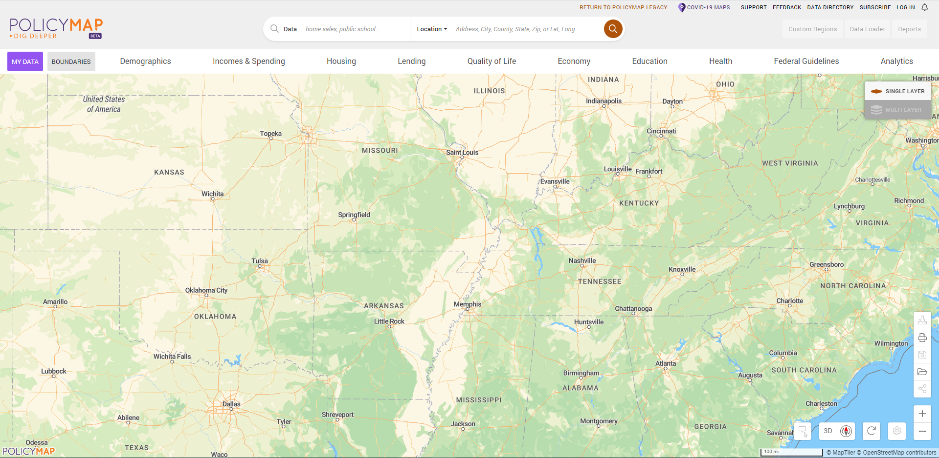
Minority Concentration Map
https://www.policymap.com/newmaps

Slide 79
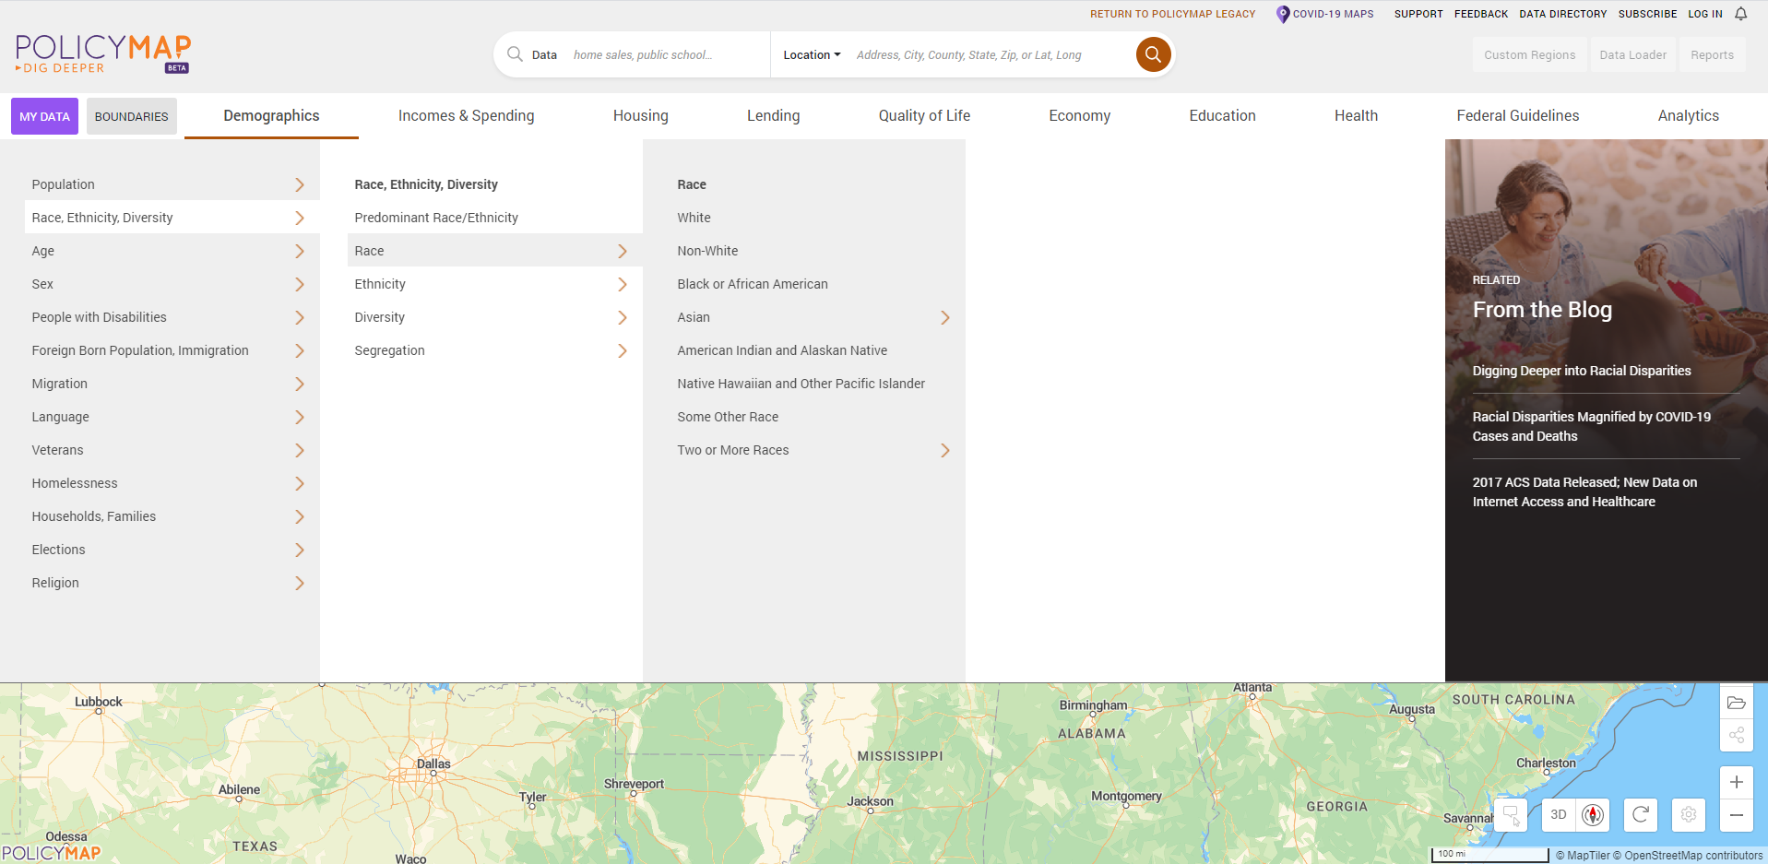
Minority Concentration Map
Select Non-White population under Demographics
1
4
2
3

Slide 80
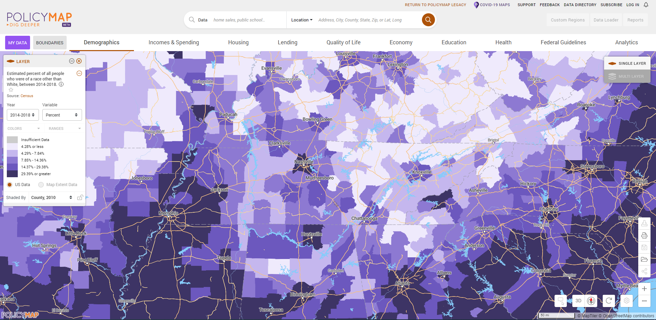
Minority Concentration Map
Zoom to the appropriate level for the application or use the search bar

Slide 81
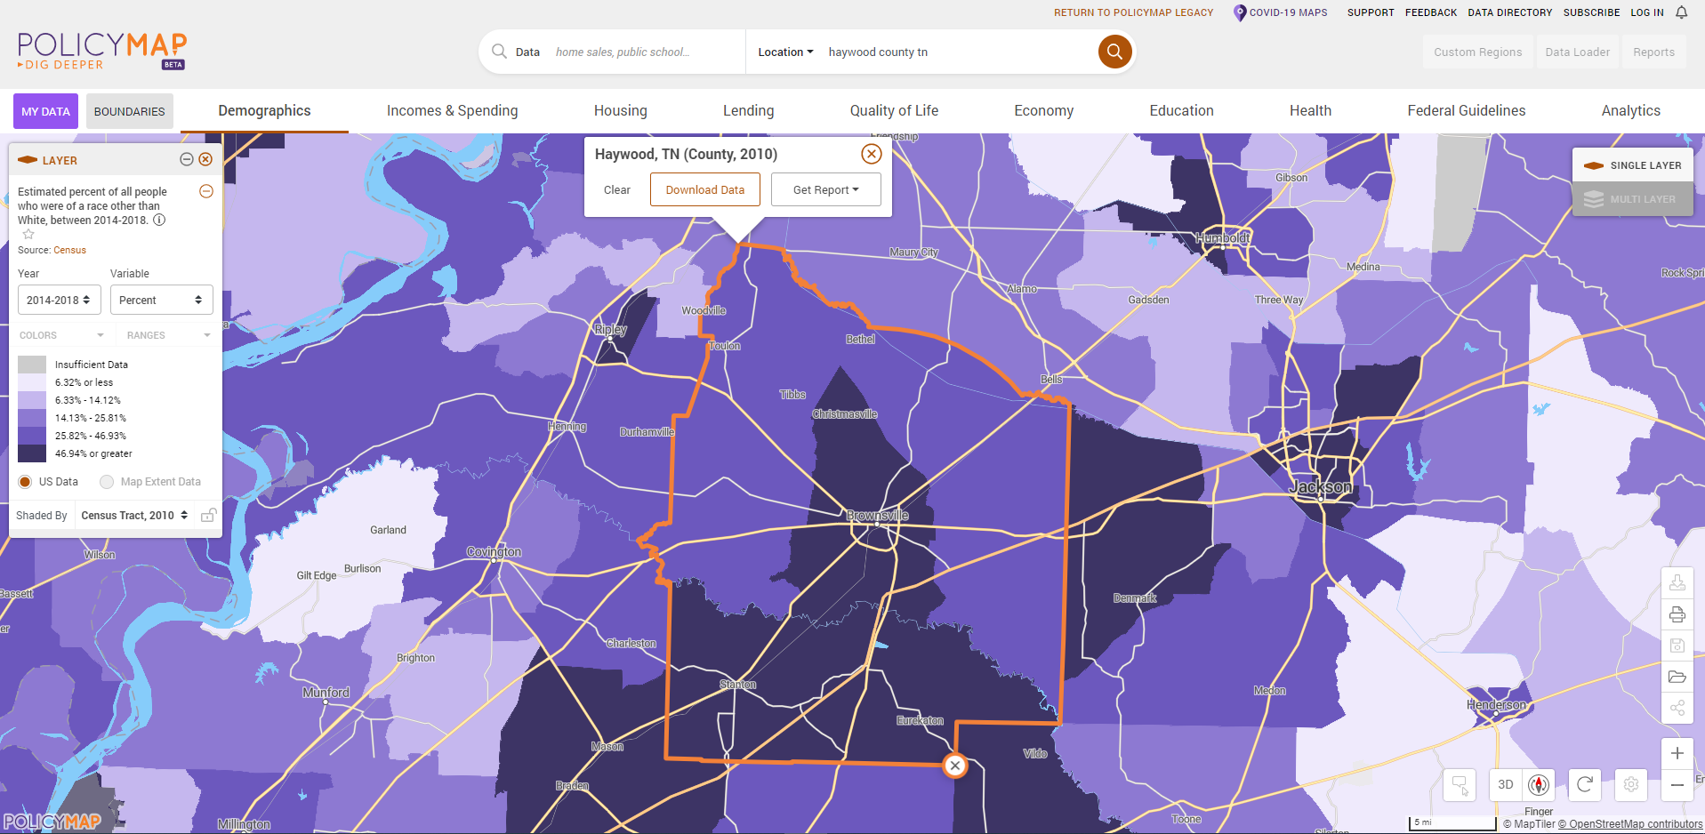
Minority Concentration Map
Select the most granular level of geography
(Block group for SJ or MJ One County)

Slide 82
Additional Documents
Utility Letters
  Must be filled out and signed by the Utility Manager
    Even if system is owned by the city, the utility manager needs to sign
  Still base the rates on 5,000 gallons of water/wastewater
  Include taxes and fees where applicable
Rate structure must be included
  Show rate structure in a way we can verify the calculation
  Rate structures in audits are usually a good format
  Do not use combined rates
Resolutions must be passed prior to submission
  Avoid exact match amounts if able
  Make sure language is up to date
* Applications without executed resolutions will not be accepted

Slide 83
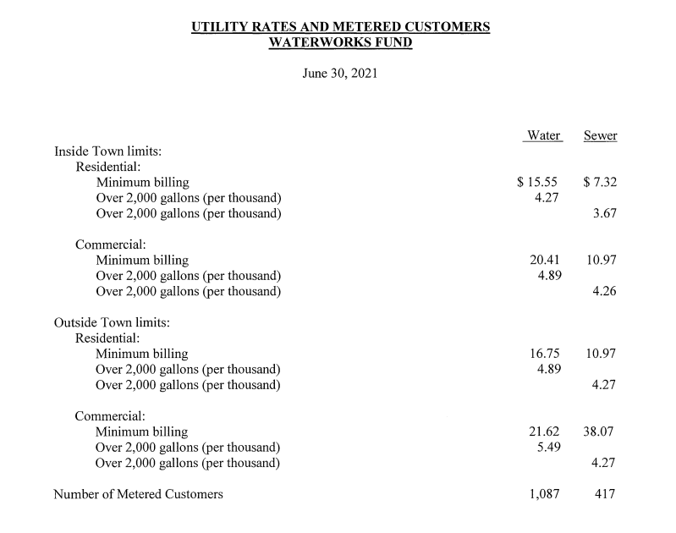
Rate Structure Sample

Slide 84
Additional Information

Slide 85
Application Process Flow
1
Public Meeting
Professional Services Procurement
PER/PAR Development & Cost Estimate
Execution of Local Resolution
Submission of Application
2
3
4
5

Slide 86
Ability to Pay
Updated annually
Match rates still 5-25%;
Data factors:
  Median household income
  Poverty rate
  Food stamp dependence
  Unemployment rate

Slide 87
Additional Information
Water and Sewer Systems
Water and Sewer System projects are only eligible for systems with 2,500 or fewer residential connections
Still no large systems
Number of connections will be collected in online applications and additional questions

Slide 88
Additional Information
Public Health and Safety
No loose equipment (kitchen sink projects)
  Including radios
Applications with smaller equipment must be concise and compelling
  SCBA system replacement
  Complete turnout gear replacement
  Etc
No backup or reserve equipment
We will prioritize large non-construction purchases like fire trucks and ambulances

Slide 89
Additional Information
Public Health and Safety
Use numbers whenever possible
Use 2-3 years of calls and amount of loss
Provide detail to separate an application from the pack
  Number of calls,
  Property loss,
  ISO improvement,
  Age of truck
  Maintenance records (not regularly scheduled)
  Photographs showing condition
  DON’T ASSUME WE KNOW

Slide 90
Additional Information
Community Infrastructure
Use numbers and data whenever possible
Think and plan. What has been the traditional approach? Is there a better way?
Does project make the community more resilient or safer?
How will the improvement be sustained and maintained?
Documentation is necessary to support your narrative

Slide 91
Additional Information
Water Line Extensions
Scored as a percentage of contaminated water sources
Need a list of samples that is legible
Double check the letter from the sampler to make sure all information is included
Need to be able to match the map to the MSF
Test 35% for the best score
Have to test at least one HH in each target area and at least 10% in each target area

Slide 92
Additional Information
Formatting
  Use the Attachment Naming Standards on the website
  Applications will not be reviewed until attachments are submitted using these naming standards
Reapplying
  Procurement is good for 2 years
  Direct beneficiary surveys need to be done every year
  Public meetings and resolutions need to be done every year

Slide 93
Project Need Scoring - Water System
Tentative (Updates in process)
100 points total
  Format (1)
  Measurement (2 points)
  Mapping (4 points)
  Planning/Repair (3 points)
  Project Need (90 Points)
    Source Capacity (50% – 90% or greater)
    Treatment Plant Capacity (50% – 90% or greater)
    Storage Capacity (150% – 59% or greater)
    Water loss (Leakage) (20% – 60% or greater)
    Pressure ≤20 psi (20% – 50% or greater, customers)
    Quality and Operational Issues
    Aging Equipment (50% - 120% or greater)
    (Age / Life Expectancy)

Slide 94
Project Need Scoring - Sewer System
Tentative (Updates in process)
100 points total
  Format (1)
  Measurement (3 points)
  Mapping (3 points)
  Planning/Repair (3 points)
  Project Need (90 points)
    Treatment Plant Capacity (50% – 90% or greater)
    Infiltration/Inflow (20% – 60% or greater)
    Lift Station Capacity (450 – 800 min or greater)
    (Avg run time / day)
    Failing Septic Tanks (10% – 100%)
    Quality and Operational Issues
    Aging Equipment (50% - 120% or greater)
    (Age / Life Expectancy)

Slide 95
Kent Archer
(615) 354-3591
kent.archer@tn.gov

