Slide 1
CDBG Application Workshop for Application Preparers
2025 Regular Round
November 25, 2024

Slide 2
Schedule
Public Meetings held by January 17, 2025
Final change orders due February 7, 2025
Final RFPs due February 28, 2025
Closeouts due February 28, 2025
Applications March 7, 2025
Account for holidays
Martin Luther King Jr. Day
Presidents Day

Slide 3
Changes for 2025
Adjust scale for max funding for public health and safety
Make construction and non-construction competitive
Adjust non-construction to $1 million scale for scoring
Reintroduce sewer line extensions.
Water lines and sewer lines will compete in the same category
Revised MSF tab in jurisdiction workbook
Will collect more data
More consistency

Slide 4
Recent Changes that Remain
Water and Sewer System applications limited to 2,500 residential connections and fewer
No large and small population for system applications
No Housing Rehabilitation applications

Slide 5
Process
Online application in SmartSimple
Working on application now
Jurisdiction calculations are in Excel again
Use this and the Application Notices (to be published in the coming weeks) as a guide
NOTE: If any information is inconsistent, the information in the Application Notices will supersede.

Slide 6
SmartSimple Applicaiton

Slide 7
General Application Information
Applicant Community
Project Title
Project Type
Project Sub-Type (if applicable)
National Objective
Application Type (single or multi-jurisdiction)
County/Counties
ThreeStar Participating County? (yes)
Brief project description
Refer to previous scopes in contracts. Ask TNECD if you are new
Number of beneficiaries
Number of LMI beneficiaries

Slide 8
General Application Information
Federal Information
Applicant FEIN
Check to be sure it matches the W-9 and Grant Payment Setup Form
SAM Unique ID
All CDBG recipients are required to have an active account in the SAM.gov system
Reach out to TNECD if you need assistance looking up a local government's UEI

Slide 9
General Application Information
Project Funding
Grantee Match Rate (before the ThreeStar reduction)
CDBG Request Amount
Other Funding Amount (include all matching funding)
Source(s) of Other Funding
Status of Other Funding
Especially important for other funding that is coming from another grant program

Slide 10
General Application Information
Personnel & Contact Information
Elected Official Name
Elected Official Phone
Elected Official Email
Applicant Community Physical Address
Engineer/Architect Name
Grant Administrator Name
Engineer/Architect Agency or Firm
Engineer/Architect Phone
Engineer/Architect Email

Slide 11
General Application Information
Legislator Information
State Senator Name
State Representative Name
Other State Representative(s) Name(s)
Do not list federal Congress men and women or Senators

Slide 12
Project Information
Project Narrative
Project description
What the project will accomplish, and what problem will be solved?
Note anything unusual
Tell us how this fits with prior projects, other current projects, and any projects in the future (not only CDBG) – show that you are strategic
Do not copy narrative from technical document
Be specific describing economic development
Job creation or loss
Sites passed over
Inability to expand
Provide backup documentation

Slide 13
Project Information
National Objective
Clearly explain how the selected National Objective is being met
If LMI benefit is selected
How is LMI met?
Census
Target Area Survey
Both
If using Target Area Survey
Explain the randomness methodology
Contact information for those who conducted surveys
Dates or date range surveys were conducted

Slide 14
Project Information
Benefit to Minority Populations
Discuss how the proposed project benefits minority populations within the service area.
Are there areas of minority concentration?
Are there any adverse or negative impacts?
Could another project have provided more benefit?
Why was this project selected over others?
Consider project location within the community
Use PolicyMap https://www.policymap.com/newmaps

Slide 15
Project Information
Benefit to Minority Populations
Discuss how minority populations were engaged during project selection.
Were additional actions taken to encourage participation at the public meeting? If so, what actions?
Were any other actions or outreach undertaken?
Look at areas of minority concentrations
Minority outreach and engagement is still lacking. Need to improve.

Slide 16
Project Information
Housing and Community Development Needs and Initiatives
Describe housing and community development needs and how they are being addressed
Do not only include funding actions
Are any policies or community initiatives underway?
Are any non-profits addressing housing needs?
How are the identified needs being addressed?
Does the local governments have any active plans that support the application?
If yes, provide some explanation and include the plan

Slide 17
Project Information
Project Construction Information
Estimated length of construction (months)
Estimated level of construction inspection
Full-time
Part-time
Property Acquisition
Estimated property acquisition cost
Estimated easement cost
Provide unique information related to acquisition

Slide 18
Performance Measures
At least one measurable output and outcome to be measured over the life of the project is required
Options contingent of project type
Output - This is a measure of the direct result of the grant funds.
Outcome - This is a quantitative measure of how the project is impacting a goal of the community.
Still a work in progress for new categories

Slide 19
SmartSimple Application Project Specific Questions

Slide 20
General Project Information
Explain why the project is essential
Describe the problem
How long has the problem existed?
What is the impact on the community?
Describe how the problem will be solved
Provide alternatives and why the proposed solution is best
Doing nothing and continuing with the current process are the same.
Neglect does not count as an alternative

Slide 21
General Project Information
Explain why the project is a priority for the community
Include reasonable and applicable documentation
Support letters are fine, but avoid canned form letters
Explain why current budget cannot address the problem
Be careful to not propose a project that the local government cannot support the maintenance

Slide 22
Project Specific– Community Infrastructure
Describe surrounding areas that may also benefit
Drainage/Flood Control
Is the target area in a floodplain? How will the area be modified?
Explain the problem specifically over the last 5 years. Are there estimates to the cost of damages?
Describe trends how the infrastructure has been or will be impacted.
Describe efforts taken to mitigate the problem in the last 5 years
Describe action by any other agencies
Sidewalk Projects (Local Roads Only)
Direct vs Indirect area benefits
How critical are the proposed streets?
Do current conditions present safety hazards?
What are they connecting?
Accessibility?

Slide 23
Project Specific– Community Infrastructure
Sidewalk Projects (Local Roads Only)
Provide any additional detail to the existing problem.
How critical are the proposed streets?
Do current conditions present safety hazards?
When were the roads/sidewalks built or last improved?
Have any studies been conducted directly related to the problem?
If yes, provide a summary of the findings.
Provide usage data.
Annual average daily traffic (AADT)
Foot traffic
Describe any efforts to solve the problem in the last 5 years

Slide 24
Project Specific – Community Infrastructure
Sidewalk Projects (Local Roads Only)
A standard for rating road or sidewalk condition has not been provided, but using a standard is encouraged
CDBG funds cannot be used for general maintenance
Filling potholes
Patches
Sealing cracks
Small bridges that do not qualify for the Bridge Repair Program are eligible

Slide 25
Project Specific – Community Revitalization
Describe surrounding areas that may also benefit
Community Facilities
Describe how the facility is an important asset and how the facility will be used once improved.
Is the building historic building? Is it on the National Register? Does this create some challenges or limitations?
Describe any efforts to solve the problem in the last 5 years

Slide 26
Project Specific – Community Revitalization
Local Parks and Recreation
Provide any additional detail to the existing problem. How severe is the problem?
Describe the existing park system. Reference any active plans that have been developed.
Describe any efforts to solve the problem in the last 5 years
Are safety hazards being addressed?
Describe action by any other agencies
Have other funding agencies been notified of the proposed project? If so, what is the response?

Slide 27
Project Specific – Community Revitalization
Local Parks and Recreation
Applications for a local parks and recreation improvement must have at least one clearly defined co-benefit
Stormwater/flood mitigation
Community health impacts
ADA accessibility
Economic benefit
Etc.
Not just a grant to build a playground or splashpad

Slide 28
Project Specific – Public Health and Safety
Describe how the project will impact emergency response
Describe emergency call trends over the last 12 months
Fire Equipment & Vehicles
Describe the existing equipment and why it is insufficient
Explain who will hold the title and be responsible for insuring the equipment
Describe the existing fire protection system and coverage areas
Describe the types and number of fires and the annual loss

Slide 29
Project Specific – Public Health and Safety
Fire Equipment & Vehicles
Describe the current ISO rating. Will the project impact the rating?
Is an automatic agreement in place with neighboring fire departments?
If yes, the agreement must be submitted as an attachment
Describe why the problem has not been previously addressed

Slide 30
Project Specific – Public Health and Safety
Emergency Equipment & Vehicles
Describe the existing equipment and why it is insufficient
Explain who will hold the title and be responsible for insuring the equipment
Describe the distance from the target area to the nearest hospital and how it affects the project
Describe why the problem has not been previously addressed

Slide 31
Project Specific – Public Health and Safety
Communications Equipment
Describe the existing equipment and why it is insufficient
Describe the existing communications system. Who is the provider? List all departments that use the system
Describe why the problem has not been previously addressed

Slide 32
Project Specific – Public Health and Safety
Buildings (Fire Stations, EMS, Clinics, etc.)
Is an automatic agreement in place with neighboring fire departments?
If yes, the agreement must be submitted as an attachment
Where is the closest similar facility? Why is it not suitable to meet the need?
Describe the estimated usage of the proposed facility and how it will primarily benefit LMI populations
Will the proposed facility benefit multiple jurisdictions?
If so, explain how and describe the other areas

Slide 33
App Documents and Submission
List of additional documents that must be included with the submission of the application
Additional documentation upload
Application “Save” or “Submit”

Slide 34
Jurisdiction Workbooks

Slide 35
Jurisdiction Workbooks
Six different options
Single Jurisdiction (Direct Beneficiary)
Single Jurisdiction (Indirect Beneficiary)
Multi-jurisdiction, One County (Direct Beneficiary)
Multi-jurisdiction, One County (Indirect Beneficiary)
Multi-jurisdiction, Multiple County (Direct Beneficiary)
Multi-jurisdiction, Multiple County (Indirect Beneficiary)
Read instructions on each sheet
Information can only be entered in blue fields
Sheets to be completed are in green
Reference and informational sheets are in black

Slide 36
Title Page
General application information
Applicant
Project Title
Project Type
Funding Information
National Objective
ATP is auto-filled based on the first entry on the Beneficiary sheet
Sign and date by application preparer and mayor

Slide 37
Beneficiary Information
List the applicant jurisdiction first
Each jurisdiction must qualify through Census or Survey
This will drive PCI calculations
LMI calculations will auto-fill for indirect; must be manually entered for direct
Look for flags if Census is selected and not 51% LMI
Project Impact calculations will show at the bottom
If MJ do not double count population

Slide 38
Beneficiary Information
Information here will drive more automatic calculations this year.
Absolutely critical that this information is correct with no flags
Triple check the Number of Households for each City or County
NOTE: Contact ECD for anything other than city or county (i.e. Census Tract)

Slide 39
PCI Worksheet
PCI and points will auto-calculate
PCI points for Census will be the same for 2022 and 2025
If reusing Target Area Surveys from a previous year, the target area PCI score from that year will be used.
Community Need score will show at bottom
All information will come from ACS data and the MSF tab

Slide 40
PCI Calculations (MJ only)
No information is entered on this page
Everything auto-calculates
Information is dependent on Beneficiary sheet
Weights PCI points based on Census or Survey and percentage of beneficiaries

Slide 41
Unemployment Rate (MJ multi-county only)
Similar to PCI Calculations
No information is entered on this page
Everything auto-calculates
Information is dependent on Beneficiary sheet
Weights UE points based on percentage of beneficiaries

Slide 42
TASS (Target Area Survey Summary)
Adjusted this year for more auto-calculation and completion
Use the Sample Size Calculator to determine the minimum number of households that must be surveyed
Input the total number of households in box AA. The rest of the information will come from the MSF tab
A separate TASS should be completed for each target area
LMI percentage for total persons and total households must be at least 51% for each TASS

Slide 43
Racial Breakdown
Adjusted this year for complete auto-calculation this year
Based on getting the Beneficiary and MSF tabs absolutely correct

Slide 44
LMI Breakdown
Adjusted this year for complete auto-calculation this year
Based on getting the Beneficiary and MSF tabs absolutely correct

Slide 45
Rate Factor
This is dependent on the Beneficiary sheet
Rate factor will now be calculated off the Census PCI
Utility rate is all that needs to be entered

Slide 46
Map Survey Form
Totals will auto calculate at top
Use the one form for all target areas
Complete all fields for each line
Much more information collected here resolve inconsistencies on other tabs
Triple check information here. This data is the basis for many calculations throughout the workbook

Slide 47
Map Survey Form
Target Area Number – corresponds with the surveys collected for each target area
Survey Number – corresponds with the survey number of each target area survey conducted. Added to bottom of TAS forms this year
LMI Breakdown – corresponds with each survey and the number of persons that fall into each LMI bracket (30%, 50%, 80%)
LMI Persons - total number of all LMI individuals living in the household. Typically all persons

Slide 48
Map Survey Form
Income Interval – corresponds with the income interval checked for each TAS. Cross-reference with PCI Worksheet tab
Survey Number – corresponds with the survey number of each target area survey conducted. Added to bottom of TAS forms this year
Total Persons in Household – total number of all individuals living in the household

Slide 49
Map Survey Form
Female Head of Household – Yes/No is the head of household is female
Number of Elderly – total number of elderly persons (62+) in each household surveyed
Number of Disabled – total number of persons with a disability in each household surveyed

Slide 50
Map Survey Form
Racial Breakdown – corresponds to the number of persons in each racial category in each household surveyed
1. White/Caucasian
2. African-American/Black
3. Asian
4. American Indian/Alaskan Native
5. Native Hawaiian/Other Pacific Islander
6. American Indian/Alaskan Native & Caucasian
7. American Indian/Alaskan Native & African American/Black
8. Asian & White/Caucasian
9. African American/Black & White/Caucasian
10. Other Multi-Racial Hispanic

Slide 51
Additional Application Documents

Slide 52
Additional Questions – Water and Sewer
Additional questions inform Project Need scoring
If a question does not apply to the project (such as failing septic tanks), an answer does not need to be provided. Scores will not be affected.
Multiple scores may be calculated, and the highest score will be applied.
Water Loss or I/I projects are not eligible for the Quality and Operations score
Include documentation as verification for points

Slide 53
Additional Documents
The CDBG Anti-displacement Plan is a separate document
2025 Budget Template
Equipment $5,000+ goes in Capital Purchase
Equipment under $5,000 goes in Other Non-Personnel
Permit costs should go in Other Non-Personnel
Remember to include costs on Budget Detail tab
Include Phase 1 ESA cost in Other Professional Fees tab

Slide 54
Additional Documents
Procurement letters
Use up-to-date letters
Send to firms with a reasonable expectation to do the work
Send to at least 3 firms
Jurisdiction maps
Must show project location (similar to ERR maps)
Must show target areas
Show jurisdictional boundaries
Minority Concentration maps
Not needed for water/sewer system-wide projects if system generally aligns with jurisdictional boundaries
Show project location
Must include all non-white populations

Slide 55
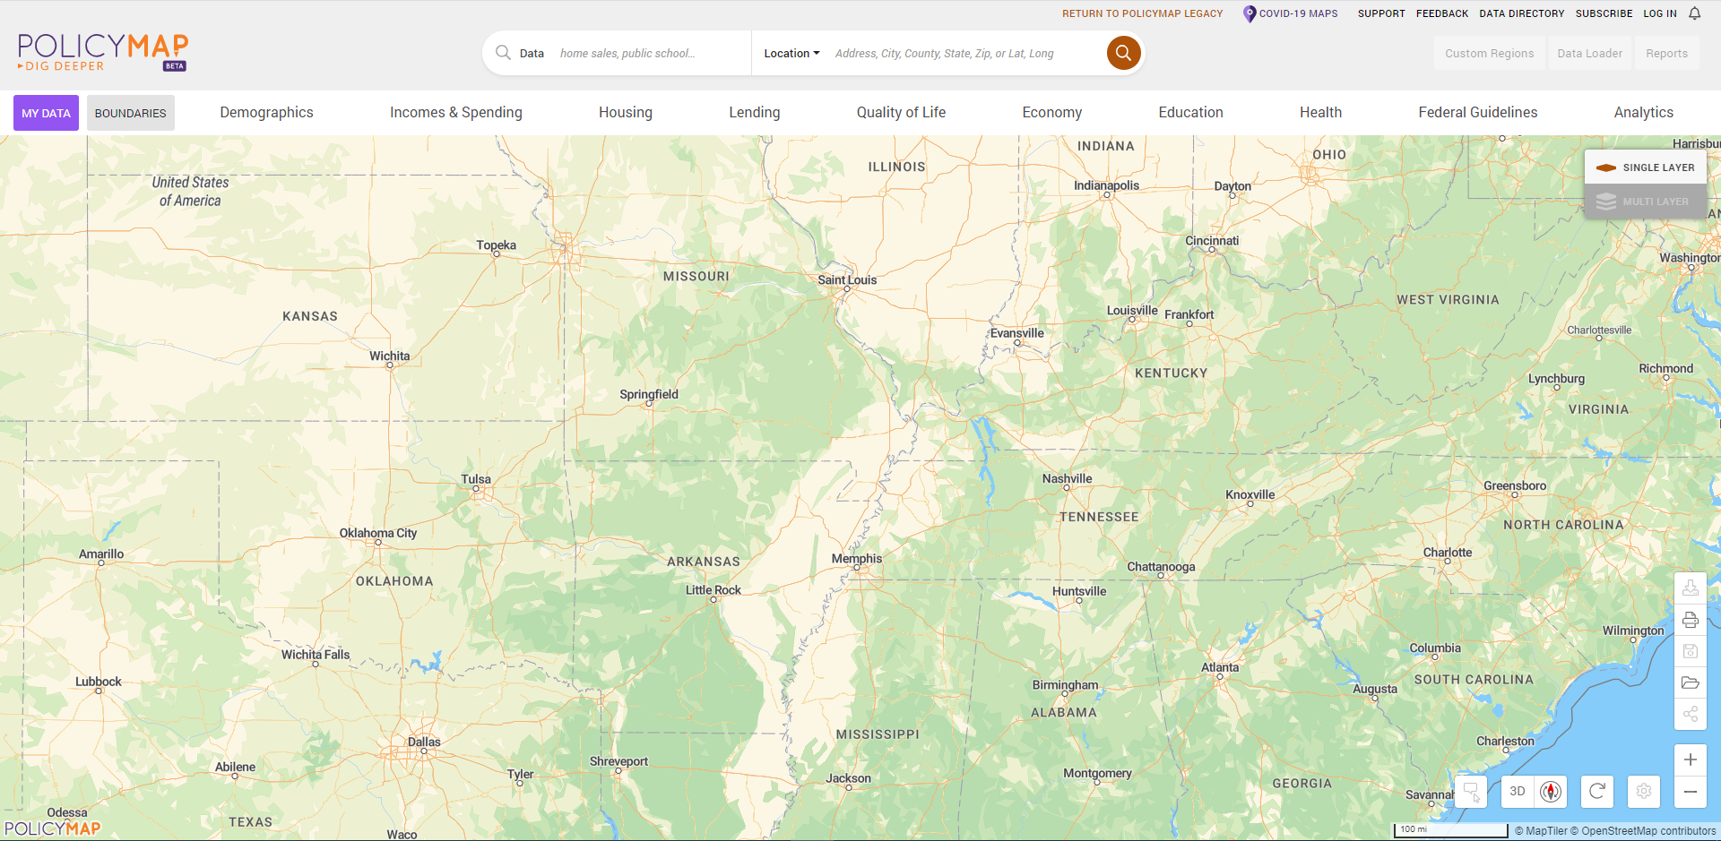
Minority Concentration Map
https://www.policymap.com/newmaps

Slide 56
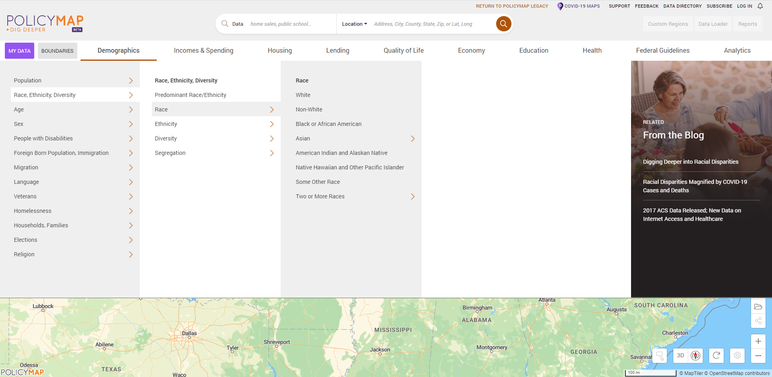
Minority Concentration Map
Select Non-White population under Demographics
1
4
2
3

Slide 57
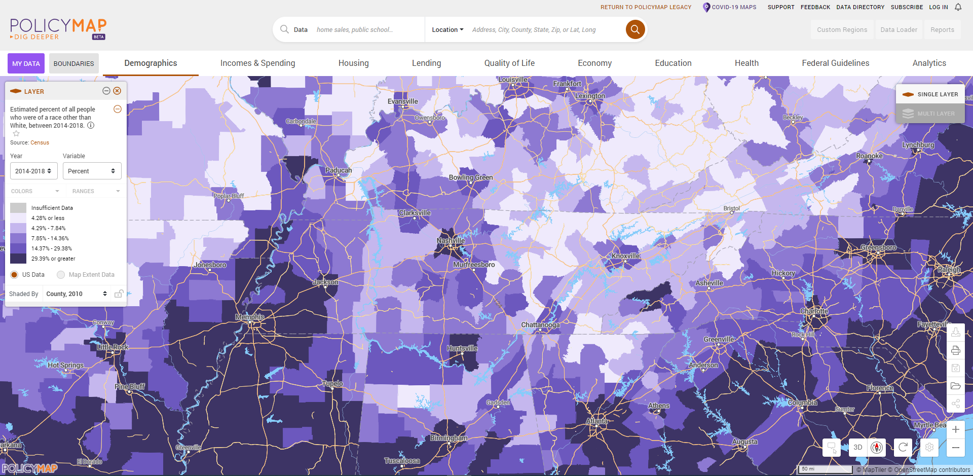
Minority Concentration Map
Zoom to the appropriate level for the application or use the search bar

Slide 58
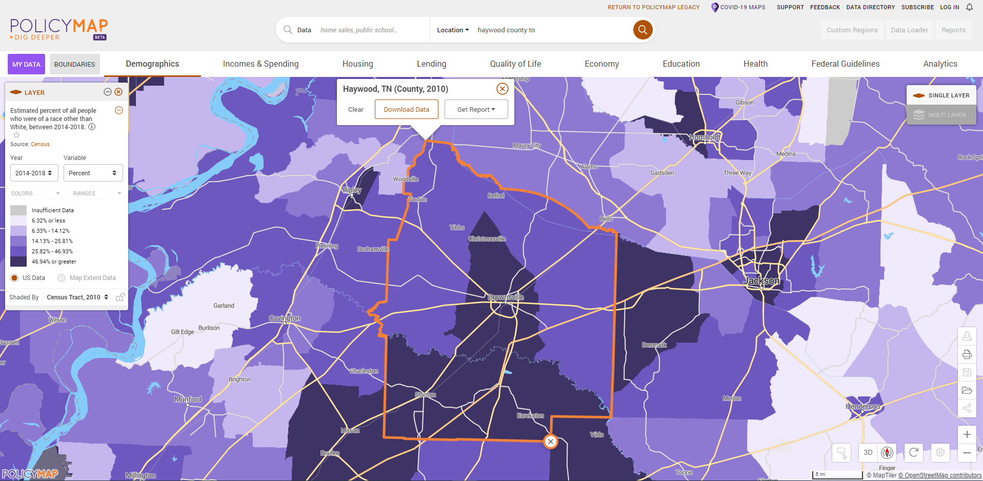
Minority Concentration Map
Select the most granular level of geography
(Block group for SJ or MJ One County)

Slide 59
Additional Documents
Utility Letters
Must be filled out and signed by the Utility Manager
Even if system is owned by the city, the utility manager needs to sign
Still base the rates on 5,000 gallons of water/wastewater
Include taxes and fees where applicable
Rate structure must be included
Show rate structure in a way we can verify the calculation
Rate structures in audits are usually a good format
Do not use combined rates
Resolutions must be passed prior to submission
Avoid exact match amounts if able
Make sure language is up to date
* Applications without executed resolutions will not be accepted

Slide 60
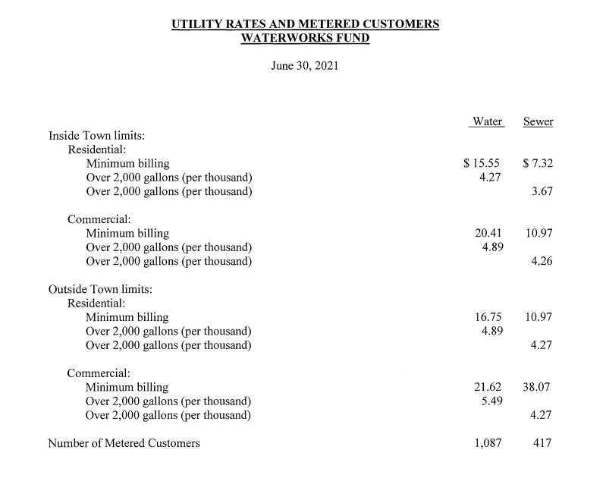
Rate Structure Sample

Slide 61
Public Meetings
At least 1 advertisement for the application meeting, at least 14 days before the meeting
Should be a display ad (stands out)
Submit a copy of the ad. Affidavits do not take the place of the ad
Should be in the legal section if possible
Include statement of non-discrimination
Must be able to document other methods of outreach and notice

Slide 62
Public Meetings
The following must be presented at a minimum
CDBG National Objectives
Eligible project categories
Funding maximum for construction and non-construction projects
Minimum match requirement of the local government
Any projects that local governments is considering for application
A request for feedback from the public
A request for any additional project considerations from the public
Ample time for the public to voice any other concerns or questions

Slide 63
Public Meetings
Public meetings are required to be in-person
May also stream broadcast virtual
Make sure at least one person from the community attends
Schedule to maximize participation
Minutes
You must document feedback in the minutes
Should be thorough and address all the minimum requirements that are presented

Slide 64
Additional Information

Slide 65
Application Process Flow
Public Meeting
Professional Services Procurement
Project development and cost estimate
Execution of resolution
Submission of application

Slide 66
Ability to Pay
Updated annually
Match rates still 10-30%;
4% ThreeStar reduction
Data factors:
Median household income
Poverty rate
Food stamp dependence
Unemployment rate

Slide 67
Additional Information
Water and Sewer Systems
Water and Sewer System projects are only eligible for systems with 2,500 or fewer residential connections
Still no large systems
Number of connections will be collected in online applications and additional questions

Slide 68
Additional Information
Public Health and Safety
No loose equipment (kitchen sink projects)
Applications with smaller equipment must be concise and compelling
SCBA system replacement
Complete turnout gear replacement
Etc
No backup or reserve equipment
We will prioritize large non-construction purchases like fire trucks and ambulances

Slide 69
Additional Information
Public Health and Safety
Use numbers whenever possible
Use 2-3 years of calls and amount of loss
Insurance savings for a home should be based on a $150,000 house
Provide detail to separate an application from the pack
Number of calls,
Property loss,
ISO improvement,
Age of truck
Maintenance records (not regularly scheduled)
Photographs showing condition
DON’T ASSUME WE KNOW

Slide 70
Additional Information
Community Infrastructure
Use numbers and data whenever possible
Think and plan. What has been the traditional approach? Is there a better way?
Does project make the community more resilient or safer?
How will the improvement be sustained and maintained?
Documentation is necessary to support your narrative

Slide 71
Additional Information
Water Line Extensions
Scored as a percentage of contaminated water sources
Need a list of samples that is legible
Double check the letter from the sampler to make sure all information is included
Need to be able to match the map to the MSF
Test 35% for the best score
Have to test at least one HH in each target area and at least 10% in each target area

Slide 72
Additional Information
Formatting
Use the Attachment Naming Standards on the website
Applications will not be reviewed until attachments are submitted using these naming standards
Reapplying
Procurement is good for 2 years
Indirect beneficiary surveys are good for at least 3 years (adjust to new PCI intervals)
Direct beneficiary surveys need to be done every year
Public meetings and resolutions need to be done every year

Slide 73
Additional Information
Income Surveys
All surveys are good for at least 3 year (March 2022 and newer)
Surveys are good for 4 years (March 2021 and newer) if the most recent ACS population estimates deviate less the 10% from the latest HUD published population figures.
Procurement
List all services being procured
Engineering design
Construction inspection
System evaluation
Etc,
Submit review and scoring with procurement documentation

Slide 74
Project Need Scoring - Water System
Tentative (Updates in process)
100 points total
Format (1)
Measurement (2 points)
Mapping (4 points)
Planning/Repair (3 points)
Project Need (90 Points)
Source Capacity (50% – 90% or greater)
Treatment Plant Capacity (50% – 90% or greater)
Storage Capacity (150% – 59% or greater)
Water loss (Leakage) (20% – 60% or greater)
Pressure ≤20 psi (20% – 50% or greater, customers)
Quality and Operational Issues
Aging Equipment (50% - 120% or greater)
(Age / Life Expectancy)

Slide 75
Project Need Scoring - Sewer System
Tentative (Updates in process)
100 points total
Format (1)
Measurement (3 points)
Mapping (3 points)
Planning/Repair (3 points)
Project Need (90 points)
Treatment Plant Capacity (50% – 90% or greater)
Infiltration/Inflow (20% – 60% or greater)
Lift Station Capacity (450 – 800 min or greater)
(Avg run time / day)
Failing Septic Tanks (10% – 100%)
Quality and Operational Issues
Aging Equipment (50% - 120% or greater)
(Age / Life Expectancy)

Slide 76
Considerations for Project Selection
Environmental Review
All acquisition and construction activities, except non-linear infrastructure require a Phase 1 ESA or Transaction Screen
Review the Flood Maps (https://msc.fema.gov/portal/home)
Take a quick look at EnviroFacts (https://enviro.epa.gov)
Scoring
If an applicant has a low Community Need score is the project strong enough and/or serve enough people to offset?
Other Funding Included
If other State/Federal funds are included, what are the requirements and timelines?

Slide 77
Considerations for Project Selection
Other Funding Available
Is this the best project for this funding? What else is available?
Timeline
What is the construction forecast? How will this impact eligibility if funded?
Build America Buy America (BABA)
Will be expanding beyond iron and steel to other construction materials
More guidance to come

Slide 78
CDBG Compliance Workshop
The upcoming CDBG Compliance workshop will be held on January 14, 2025

Slide 79
Kent Archer
(615) 354-3591
kent.archer@tn.gov

